Slide 1
Social Media Advocacy
Lisa M. Costello, MD, MPH, FAAP

Slide 2
No financial disclosures Permission to share on social media Twitter: @LisaCostelloWV
Thank you @AmerAcadPeds – slide content

Slide 3
What is Social Media?
It’s …
Having conversations
Making connections
Building relationships
Sharing resources
Distributing information
Networking
Collaborating
Fostering Engagement
Advocating
@LisaCostelloWV

Slide 4
What Social Media is NOT …
An instant tool for changing firmly entrenched viewpoints
Though it can advance and encourage dialogue
A platform to easily distinguish valid replies from targeted misinformation
Proactive information intake and open communication means knowing when and what to respond
A solution in and of itself; just being there is not enough
Active, engaged and consistent presence can accomplish goals
@LisaCostelloWV

Slide 5
A Note of Caution
Think before you message: HIPAA and professionalism applies to social media platforms
Before you blog, post or tweet, make sure your message doesn’t have any identifiable information that could be connected to a patient
Online, there are no firewalls: your digital footprint is holistic and accessible
Even on personal web platforms, consider what you share (& that it is traceable)
What would you want your patients and students to know (or not) about you?
Know your institution’s policy (if they have one)
Teach digital professionalism
@LisaCostelloWV

Slide 6
Pick your platform
Ask yourself the right questions to determine the right social media platform
What is your current digital identity?
What is your end goal?
What kind of content are you sharing?
Who do you want to communicate with?
How much time can you allocate?
@LisaCostelloWV
Notes:
How many engaging on social media already

Slide 7
Which is right for me?
Twitter: short bursts, links to content
Facebook: interactive multimedia
YouTube: video
Blogs: long form information sharing
Pinterest: photos and infographics
LinkedIn: professional networking
Flickr and Instagram: photo-sharing
Snapchat: short “self-destructing” messages
TikTok: videos, mostly with music
@LisaCostelloWV

Slide 8
Handles & Hashtags to Follow
Twitter
Facebook.com/
Handles:
@AmerAcadPeds
@AAPPres
@AAPNews
@HealthyChildren
@PASMeeting
@AcademicPeds
Hashtags:
#tweetiatrician
#putkids1st
#APAAdvocacy
#APA2020
#VoteKids
AmerAcadPeds
AAPNews
HealthyChildren
AAPFederalAffairs
AAPPeds
Pediatric Academic Societies Meeting
APA - Academic Pediatric Association
@LisaCostelloWV

Slide 9
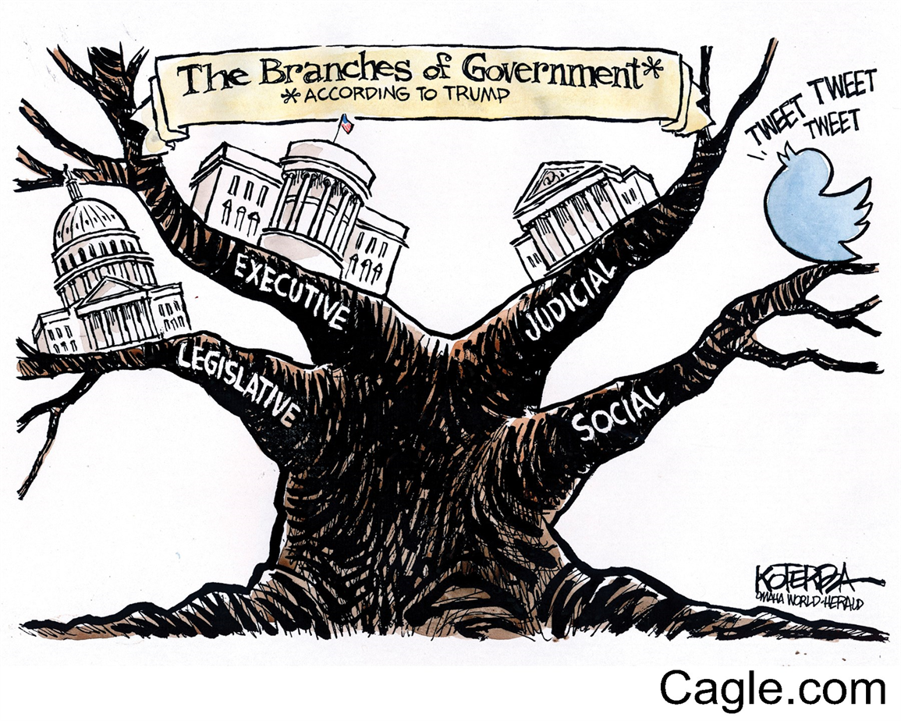
@LisaCostelloWV

Slide 10
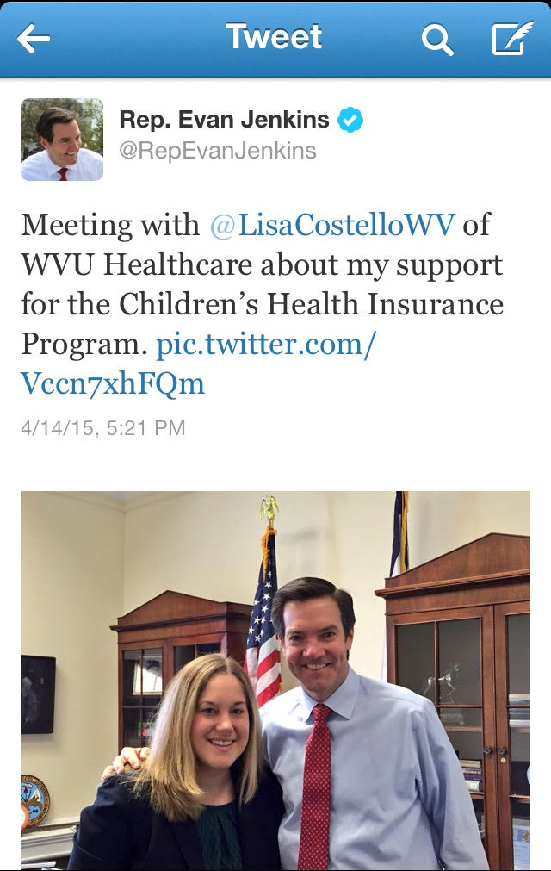
Where to Advocate
Individual Level
Community fair, schools
Op-Ed or Letter to Editor
Participate in organizations
Call, email, meet with legislators
Social Media
Testify
Vote
@LisaCostelloWV

Slide 11
@LisaCostelloWV

Slide 12
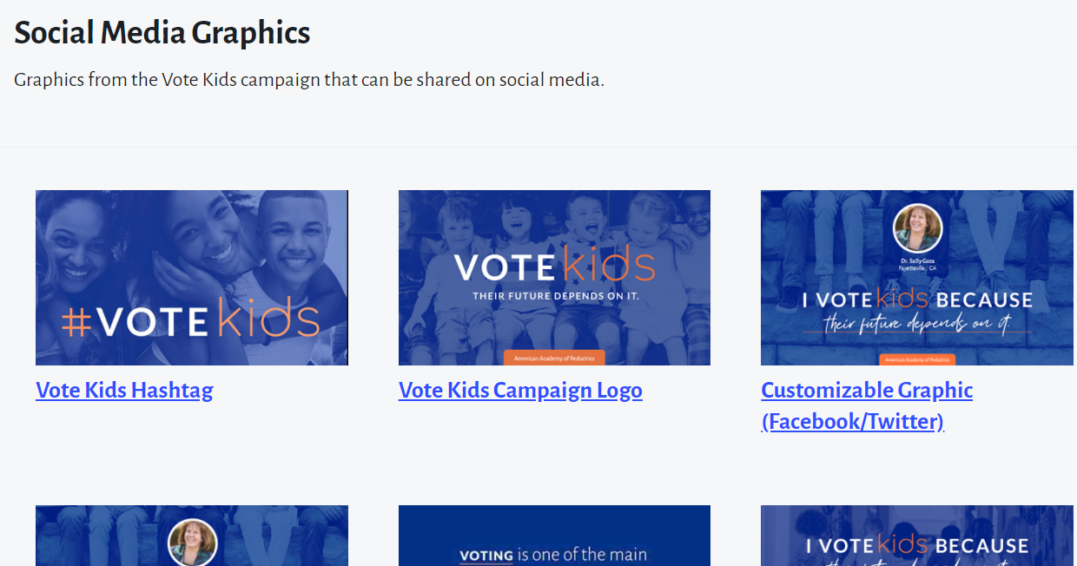
#VoteKids
https://services.aap.org/en/advocacy/election-vote-kids/social-media-messages/
@LisaCostelloWV
Notes:
Have participants go to website or use a precrafted message or their own

Slide 13
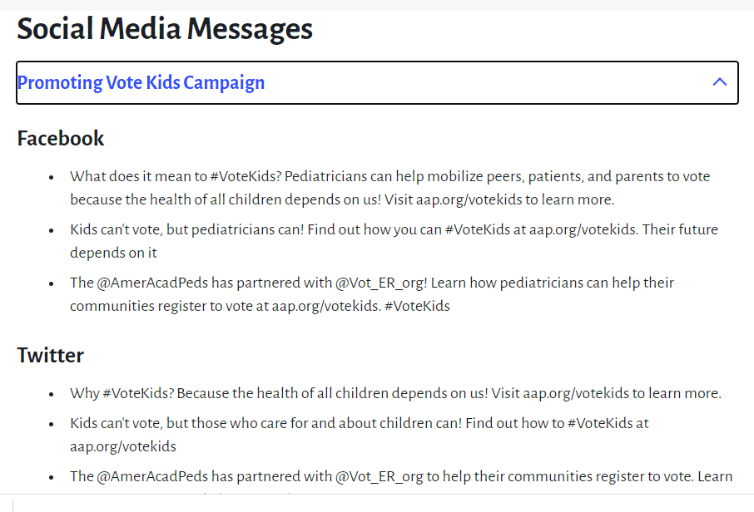
@LisaCostelloWV

Slide 14
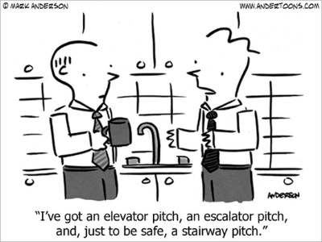
Adapt as needed

Slide 15
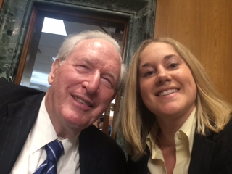
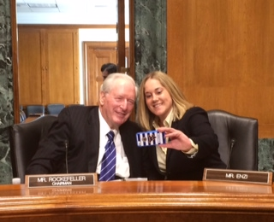
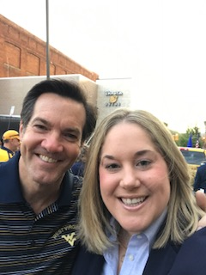
Your Voice Makes a Difference
Be Ready
#tweetiatricianselfie
@LisaCostelloWV

Slide 16
#ThankYou
Questions/Comments
@LisaCostelloWV

