Slide 1
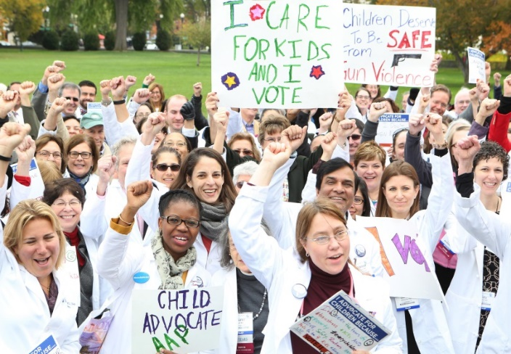
Communicating to Legislators and the Media
Lenore R. Jarvis MD, MEd
Director of Advocacy and Health Policy, Division of Emergency Medicine
Child Health Advocacy Institute Affiliate Faculty, Children's National Hospital
Assistant Professor of Pediatrics, The GWU School of Medicine and Health Sciences
President, D.C. Chapter of the American Academy of Pediatrics

Slide 2
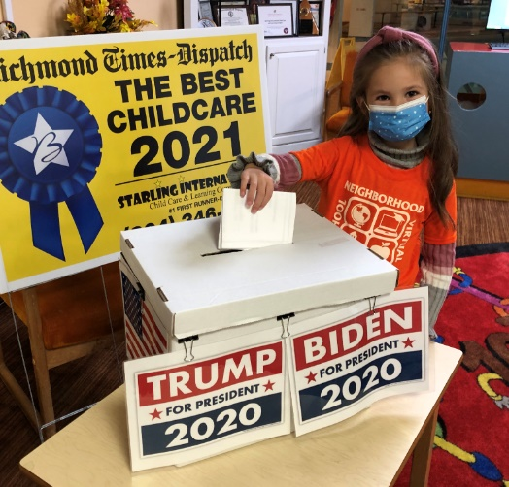
Objectives
Individuals practice communicating a clear, concise message.
Review necessary skills and competencies of an elevator speech.

Slide 4
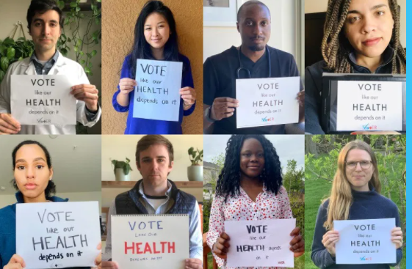
Quick Storytelling Tips
Your message should be:
Clear
Concise
Memorable & relatable
Persuasive
Include ask
Repeated
“Voting is one of the main ways we can influence the public policies that address health inequities in our communities.”
Tamar Magarik Haro
Senior Director, Federal & State Advocacy
Jamie Poslosky
Senior Director, Advocacy Communications
Notes:
Communication – key for
Communicate with legislators – testimony, briefing, lobbying
Writing editorial letters, op-eds
Media, social media, and blogs
Step 1: Identify Your Audience. ...
Step 2: Develop Your Message (as above). ...
Step 3: Make it Digestible and Actionable. ...
Example:
Good afternoon, my name is Dr. Lenore Jarvis. I am a pediatric emergency medicine physician at Children’s National Hospital.
Thank you for this opportunity to speak at this press conference today, especially as an advocate for child health and safety.
In the emergency department, I diagnose, treat, and fix medical concerns all of the time. I am comfortable and confident treating ear infections, strep throat, asthma attacks, and even broken bones and gun shot wounds. However, unfortunately, I sometimes face times where I feel completely unprepared to help my pediatric patients.
Last week, I had an 8-year-old girl who came into the ED unresponsive. Her life was threatened because of her diabetes. During COVID, her family lost her health insurance, and they ran out of her insulin medication to give her. This 8-year old girl almost lost her life from a completely treatable, preventable condition.
Voting is one of the main ways we can influence the public policies that address health inequities in our communities, including access to health insurance for our children. This election, we encourage pediatricians and those who care about children to vote like children's futures depend on it.
Election Day 2020 is Tuesday, November 3. Everyone deserves the opportunity to live to their full health potential.
Get out and vote for out children and their health.
https://services.aap.org/en/advocacy/election-vote-kids/key-child-health-issues/

Slide 5
Media - Sound Bites
Election Day 2020 is Tuesday, November 3.
Everyone deserves the opportunity to live to their full health potential.
Voting is one of the main ways we can influence the public policies that address health inequities in our communities. This election, we encourage pediatricians and those who care about children to vote like children's futures depend on it.
AAP.org/VoteKids
Notes:
The concept of a sound bite is similar to an elevator speech. A sound bite is the verbal equivalent of a newspaper "quote". It is a short, catchy snippet of speech, usually between 5 and 10 seconds, which television and radio use in their reports to summarize your opinion or make a point.
Good Things Happen When you Speak In Sound Bites:
You get your desired point across and make a good impression
Sound polished
Increase your chances of being interviewed again (could be a stepping-stone to becoming a regular on-air expert)
You will make the story and get quoted
Steps to Getting A Great Sound Bite:
Write down the quote you’d like to have in the story
Include 2-3 short sentences
1 main point per quote
Succinct, clear information
A length of 5-15 seconds long – read the quotes aloud to ensure they stay within this time constraint.
Practice saying the quote aloud – multiple times!
https://www.ourcommunity.com.au/marketing/marketing_article.jsp?articleId=1539#:~:text=The%20concept%20of%20a%20sound,opinion%20or%20make%20a%20point.
http://oncameraskills.com/media-training/rock-the-interview/talk-sound-bites-every-media-interview/

Slide 6
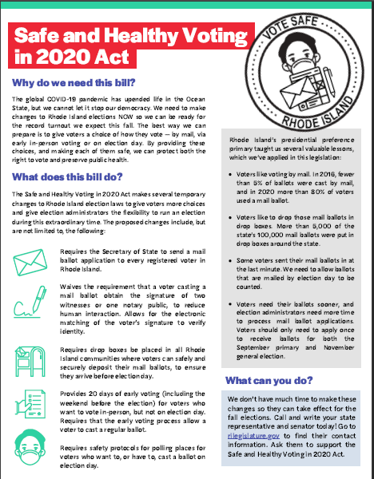
Lobbying - One-Pager
Your message should be:
Clear
Concise
Memorable & relatable
Persuasive
Include ask
Repeated
Notes:
What is the story you are telling?
• A short, one-page summary (or “one-pager”) is an example of a briefing material that can help you explain an issue or position that you or your organization has taken.
• After deciding which story you want to tell, think of the helpful facts that support your position.
• This can include background information, helpful statistics or figures, or highlight stories from your community.
Know your audience.
• Including information that is specific to the office you are meeting with can be helpful way to stand out. For instance, highlighting how many people in a certain state or district will be affected by a policy can be an effective way to make sure your message is received.
• If the meeting is about a specific problem, be sure to include what solution or what specific action you believe a policy maker should take.
• If you are representing a large group or organization, or if you are working with limited resources, it is important to create something that many people can use so that you are sharing a common message.
Don’t forget the details! • Use your peers! The best way to know if you have created something that is interesting and helpful is to have an extra pair of eyes review it. Try sharing it with someone who is unfamiliar with the issue to gather some feedback.
• Double check for spelling and typo errors. A document filled with errors is distracting and affects how others perceive your organization and mission.
• Is the font size and style easy to read? It is always best to choose something generic that will not distract from your message.
• Did you include your organization’s logo and contact information? Make sure the person you are sharing this resource with knows how to connect with you
https://www.commoncause.org/rhode-island/wp-content/uploads/sites/26/2020/06/VoteSafeRI-One-Pager-UPDATED.pdf
https://www.publicknowledge.org/assets/uploads/blog/RP_Capitol_Hill.pdf

Slide 7
Elected Leaders Asks – COVID-19
All elected leaders must advance policies that prioritize the health of children and families as our country continues to face this global health pandemic. It is essential that pediatricians have access to immediate financial relief that enables them to continue providing care to children. The AAP is calling for stronger federal leadership and enhanced financial support in Medicaid, resources for schools, telehealth, vaccines, testing, and other core components of pediatric care.
Additional resources and action are needed to address skyrocketing rates of food insecurity in households with children. More must be done at all levels of government to ensure the COVID-19 response accounts for children's special needs, including justice-involved youth, children from low-income families, children in the child welfare system, and children in immigrant families.
https://services.aap.org/en/advocacy/election-vote-kids/key-child-health-issues/
Notes:
If time, have people practice

Slide 8
Elected Leaders Asks - Racism
We must dismantle racism at every level, from individual to institutional to systemic. Elected leaders at all levels of government must advance policies that reduce disparities and advance social justice. Policymakers need to evaluate current policies through a racial equity lens, eliminate racist policies and create anti-racist policies.
This includes advocacy for improvements in the quality of education in racially segregated urban, suburban, and rural communities, policies that support implicit-bias training in schools and robust training of educators in culturally competent classroom management. It also involves advocacy for alternative strategies to incarceration. Policymakers must develop alternatives for the management of nonviolent youth behavior. In order to impact children of color, this approach cannot be limited to nonviolent youth; mass incarceration impacts families and communities where kids live, learn and play. It must also include advocacy for fair housing practices, including access to housing loans and rentals that prohibit the persistence of historic “redlining”, as well as addressing environmental inequities.
Racism is a public health crisis and our elected leaders must stand ready to recognize it as such and advance policies that address racism through a public health lens.
https://services.aap.org/en/advocacy/election-vote-kids/key-child-health-issues/
Notes:
If time, have people practice

Slide 9
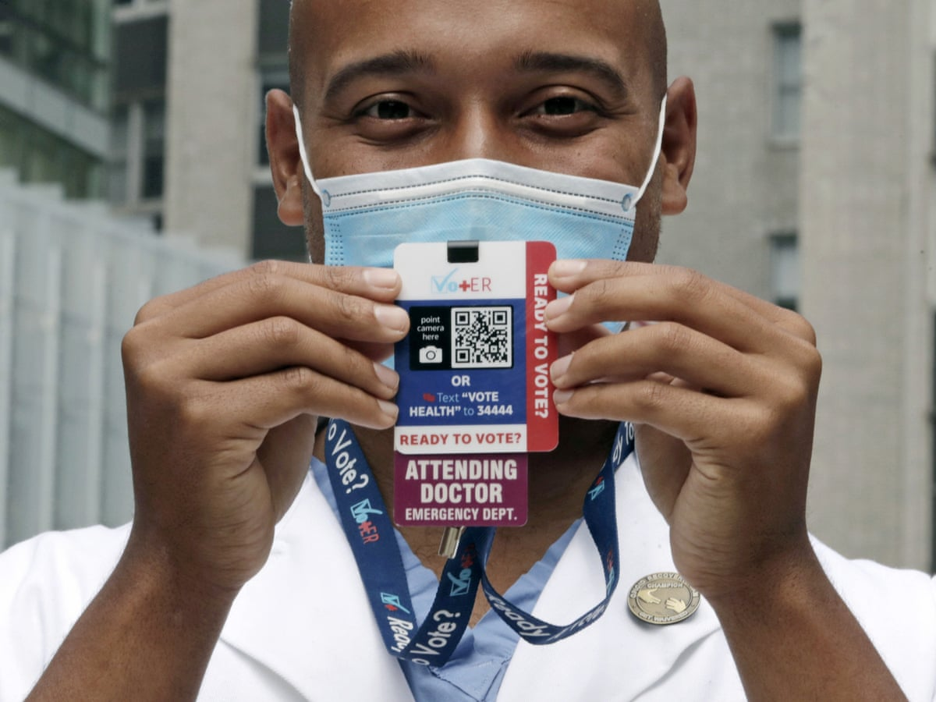
Remember
You are the child health expert
Use opportunities to educate
Offer yourself as a resource
Follow-up, follow-up!
Vot-ER.org/
Tamar Magarik Haro
Senior Director, Federal & State Advocacy
Jamie Poslosky
Senior Director, Advocacy Communications

Slide 10
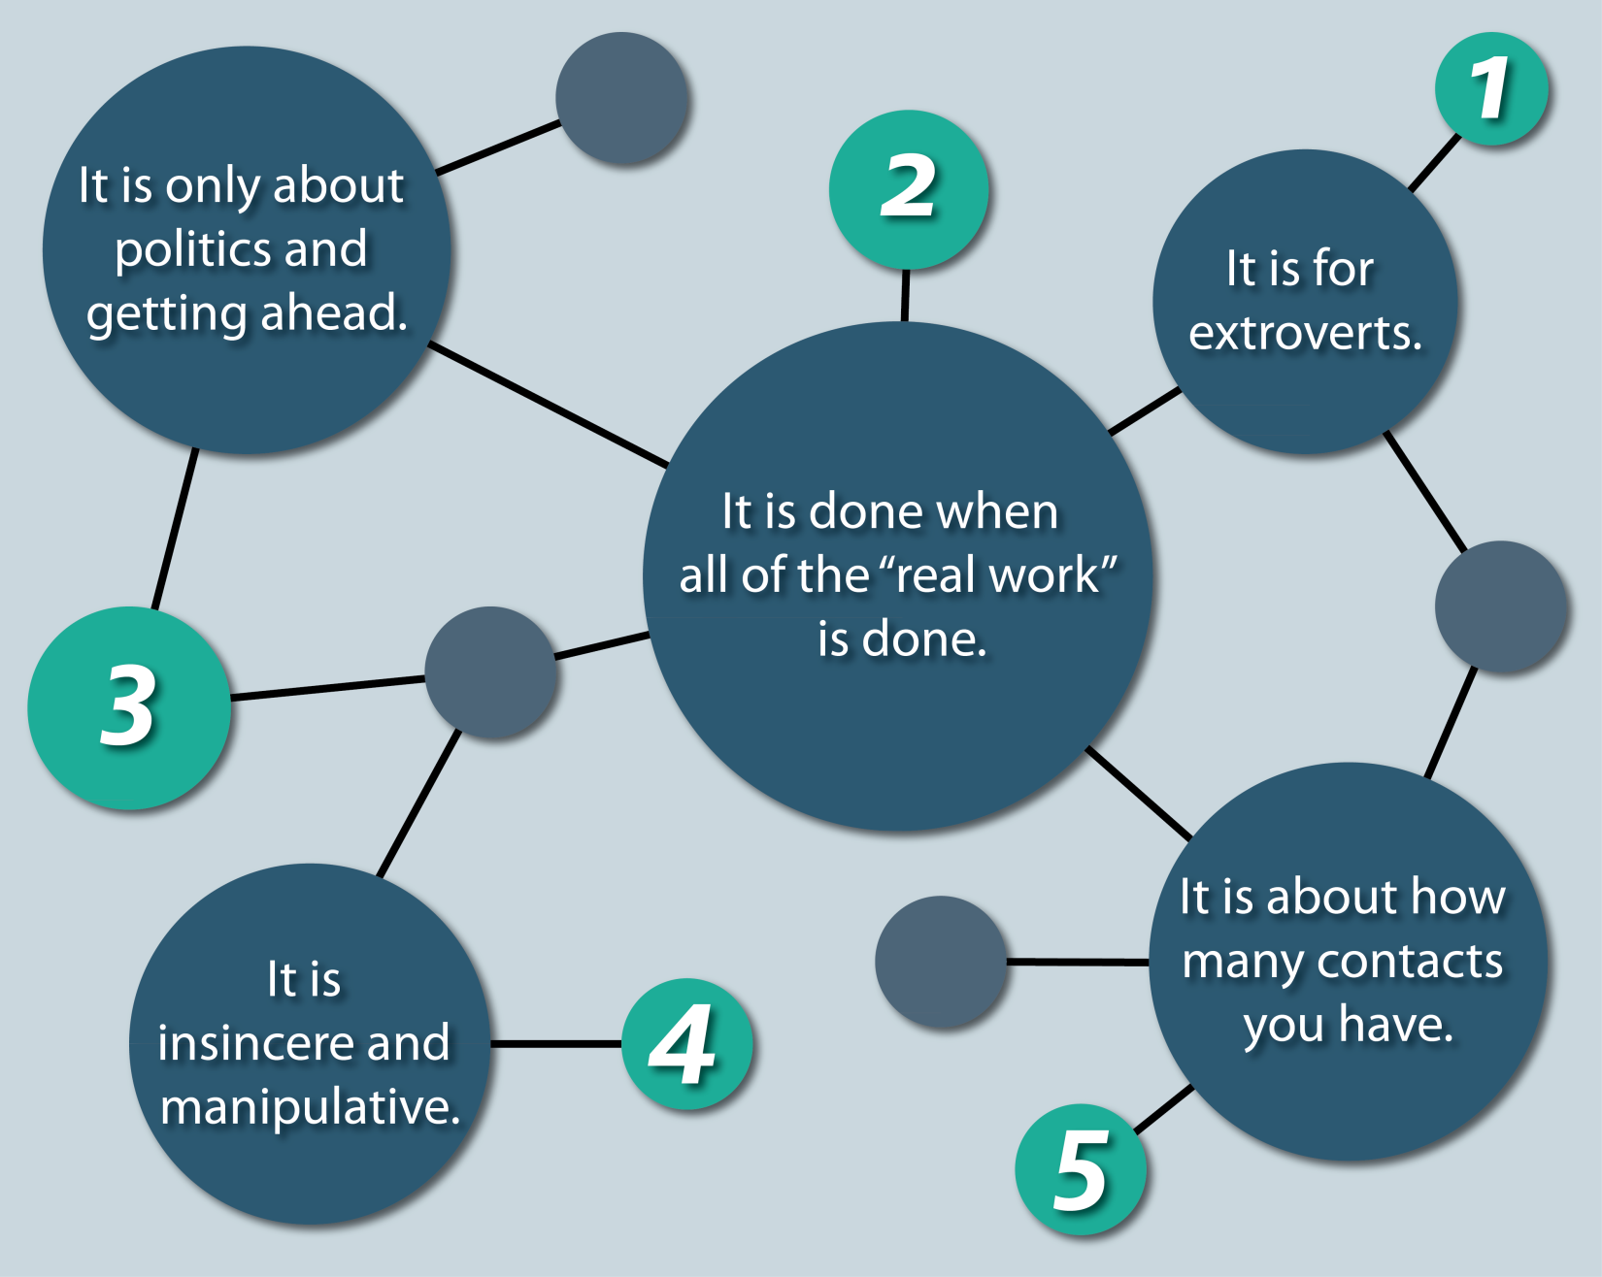
Networking Myths
https://www.ccl.org/wp-content/uploads/2015/05/5-Myths-about-Networking-01.png

Slide 11
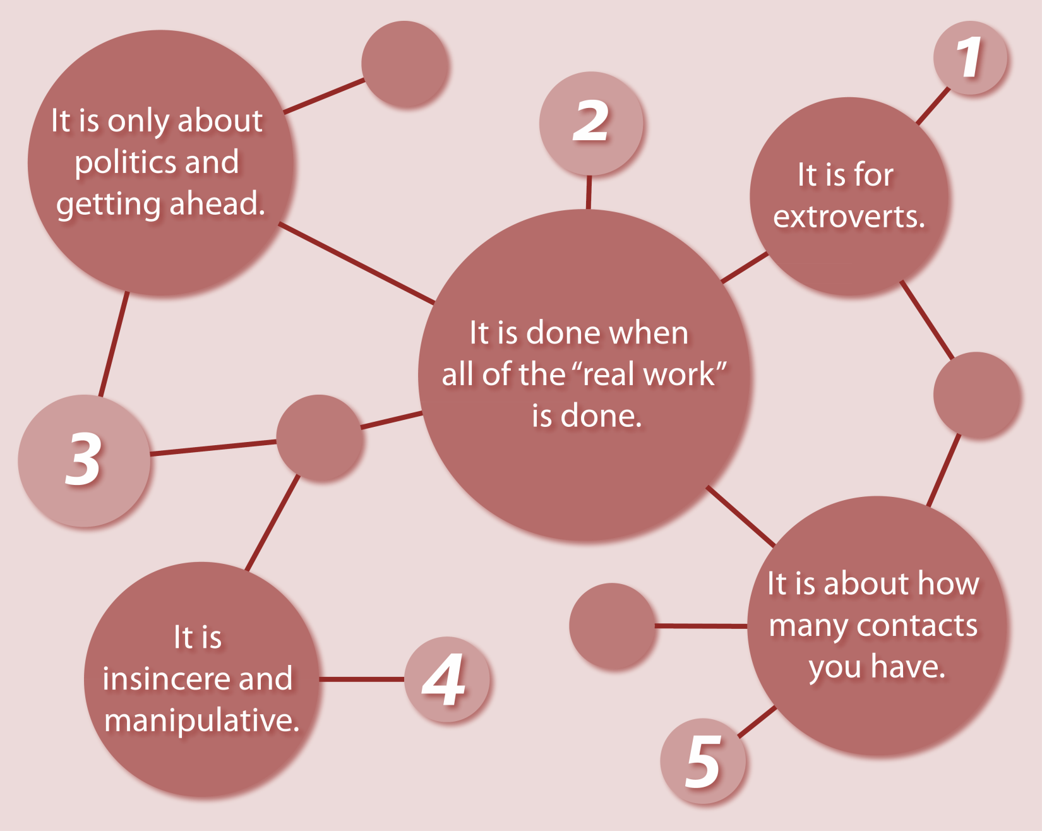
Reframing Networking: Beyond the Business Card
Relationship
Building
It is for everyone
Authenticity
Collaboration
Common
Goals
Notes:
https://www.ccl.org/wp-content/uploads/2015/05/5-Myths-about-Networking-01.png
Think about networking as the gateway to collaboration
The development of relationships
The means to achieve a certain goal
The way to meet people that are like-mined, share the same core values and will be good to work with
Remember – working together is what makes success possible

Slide 12
Networking: Elevator Pitch
Quick introduction
What are you seeking
Experience
What can you offer
Keep it short and simple!
You can have multiple pitches.
Notes:
A good elevator pitch should last no longer than a short elevator ride of 20 to 30 seconds, hence the name. They should be interesting, memorable, and succinct. They also need to explain what makes you – or your organization, product, or idea – unique.
I am Dr. Lenore Jarvis. I noticed in my Emergency Department that caregivers – mothers and fathers – were presenting with infants that were “fussy,” but on exam, there was nothing wrong with the baby. However, they were not reassured by the normal exam. I found that this was a missed opportunity to diagnose perinatal mood and anxiety disorders – several of these caregivers were suffering from postpartum depression, anxiety, or suicidal thoughts. As a result, my perinatal mental health task force has implemented universal screening for PMADs so that we can provide real-time linkage to interventions and resources to improve the health of our infant patients and their families.
If time, have people practice

Slide 13
Vot-ER.org/
AAP.org/VoteKids
ljarvis@cnmc.org

Slide 14
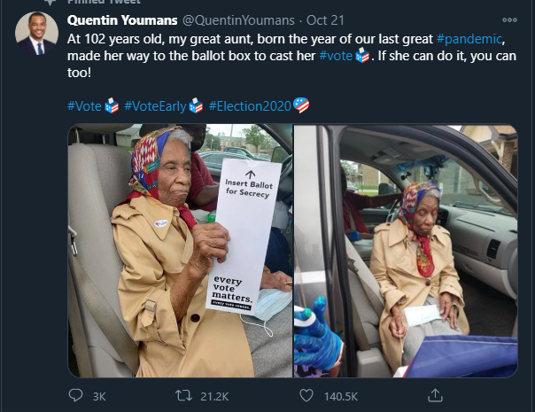
In a matter of hours, the tweet garnered over 10,000 retweets and over 67,000 likes and grabbed the attention of former President Barack Obama.

