Slide 1


What is ahead and how to get involved
Notes:
-So, we know what we have been all been wading through the past 9 months—what is ahead of us?

Slide 2

The PPC is dedicated to improving the health and well‐being of the nation's children by supporting public policies to advance pediatric research, pediatric training, and quality health care for children and families.

Slide 3
Pediatric Policy Council Priorities
Improving Health Care Access and Coverage for Children
Expanding Child Health Research
Strengthening the Next Generation of Pediatric Researchers
Improving the Resources for Socially, Developmentally, and Nutritionally Vulnerable Children
Recent PPC Anti-Racism and Health Equity Activities
Urging the federal government to use state Medicaid program design to address health disparities
Advocating for demographic data collection and reporting on COVID-19 patients
Promoting voting as a tool to improve health equity
Publishing APS Racism Commentary Series: At The Intersection of Equity, Science, and Social Justice
  “Racism as a Public Health Issue”
  “Challenges and Opportunities in Academic Medicine”
  “Organizational Solutions: Calling the Question”
  “Holistic Promotion of Scholarship and Advancement”

Slide 4
PPC: At the Intersection of Equity, Science, and Social Justice

Slide 5
American Academy of Pediatrics (AAP) Approach to Equity
The AAP articulates as an ideal that all children and all systems of care maintain health equity. The AAP will equip pediatricians with the knowledge, skills, and resources needed to create equitable systems and ultimately optimal health for all children.

Slide 6
What Is the AAP Equity Agenda?
Board
Committees
Programs
Members
Child Health
Equity
Chapters
Education
Advocacy
Community
Practice
Councils
Foster Diversity
and Inclusion
Address Bias and
Discrimination
Accountability
Partners
Policy
Sections
Staff

Slide 7
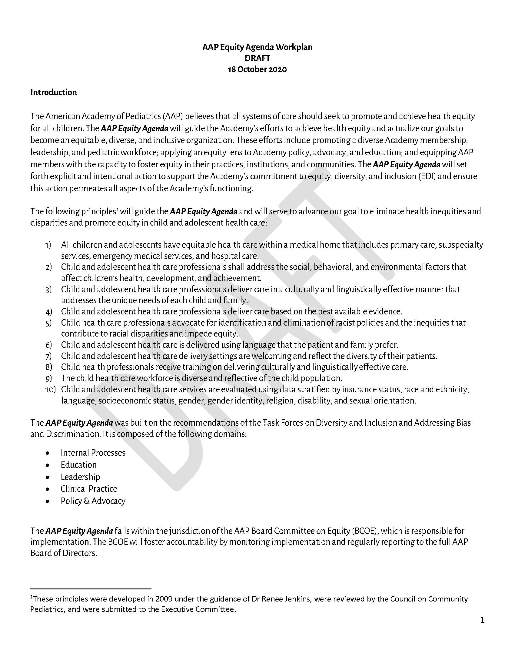
Equity Work Plan: Domains
Built upon recommendations of the Task Force on Diversity and Inclusion and the Task Force on Addressing Bias and Discrimination
Domains:
  Internal processes
  Education
  Workforce & Leadership
  Clinical Practice
  Policy & Advocacy

Slide 8

AAP Organizational Structure
Health Equity for All Children
Policy & Advocacy
Health Equity for All Children
Clinical Practice
Workforce & Leadership
Education
Infrastructure to Support AAP Equity Agenda Implementation

Slide 9
Equip Pediatricians
Clinical Knowledge
Structural Competence
Community Partnerships
Leadership skills

Slide 10
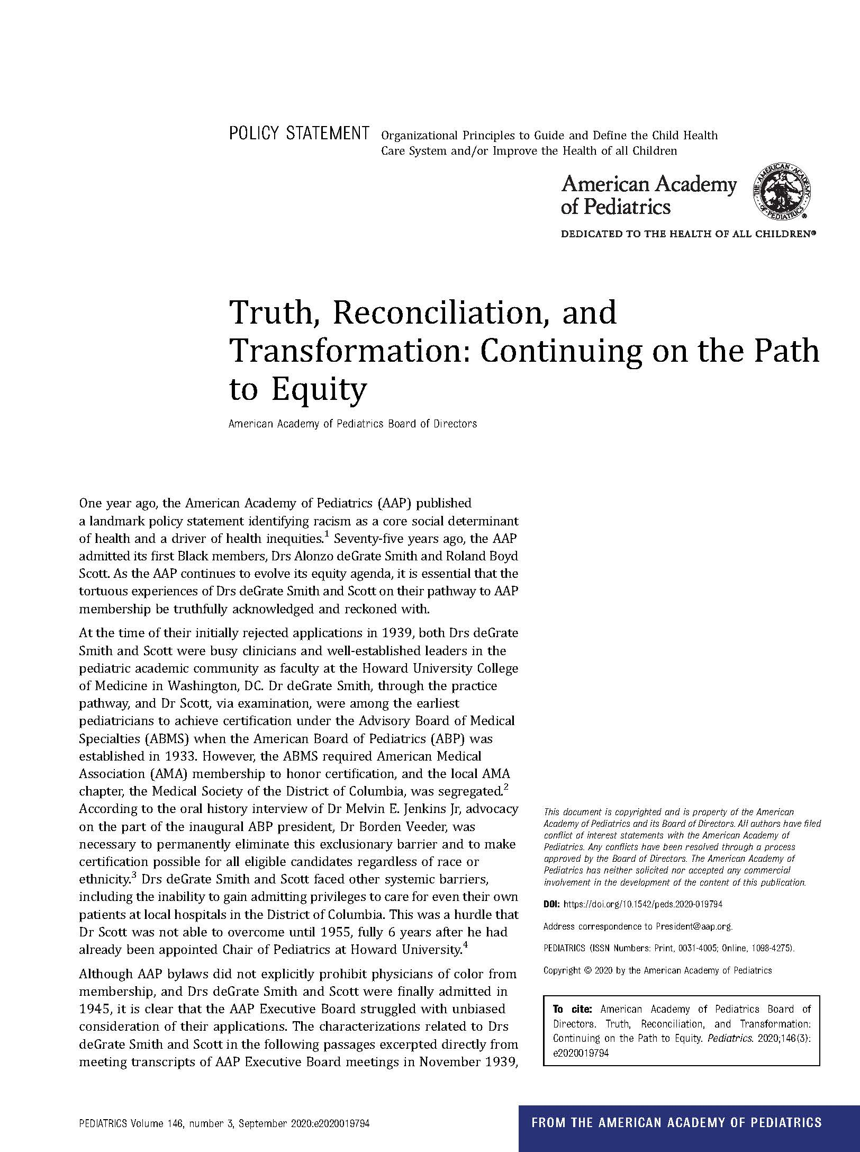

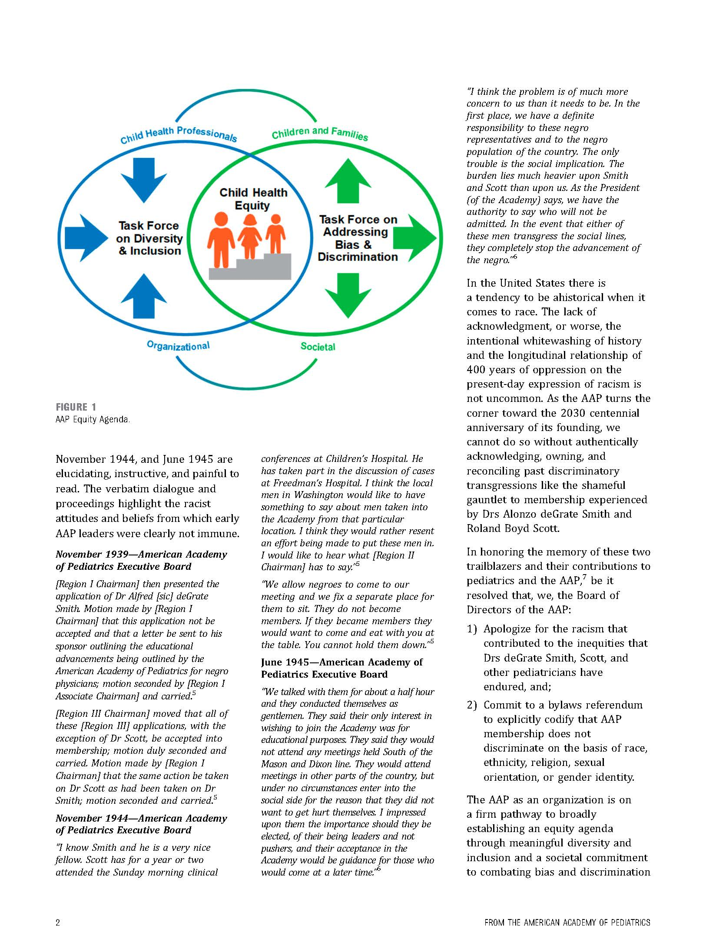
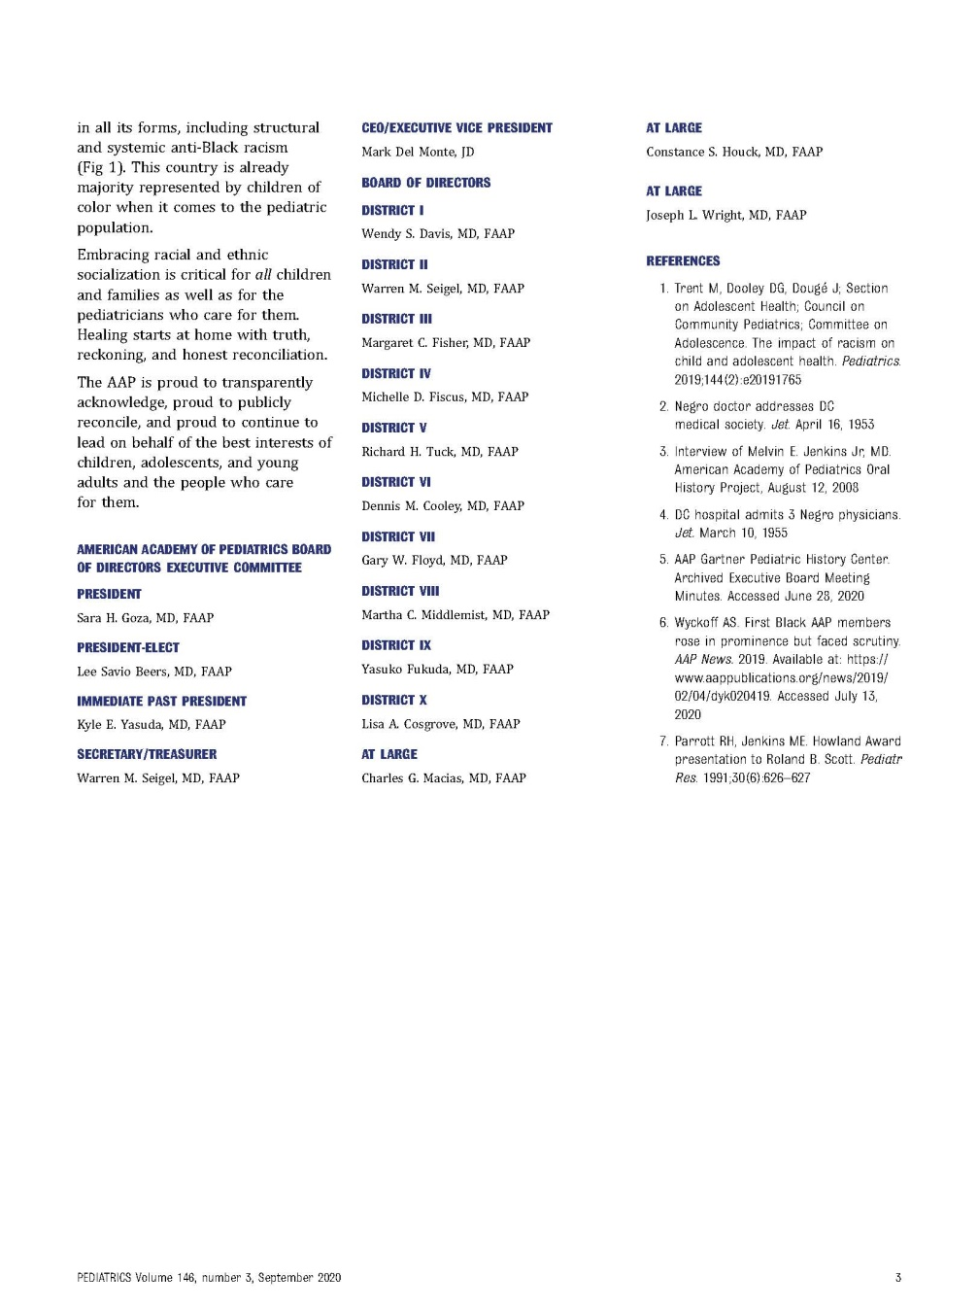
Notes:
To that end, the Academy has published a statement entitled, “Truth, Reconciliation, and Transformation: Continuing on the Path to Equity,” in the August issues of Pediatrics and AAP News; a statement that was unanimously passed by the AAP board early in July. The statement acknowledges that the AAP has not always lived up to its founding ideals and apologizes for the racism that contributed to the inequities that Drs. deGrate Smith, Scott, and – importantly - other pediatricians since and even now, have endured.
This apology is long overdue – and a precondition for a better future. Though AAP bylaws never explicitly prohibited physicians of color from membership, they did not go far enough to ensure their eligibility and acceptance, language that endures into even our current bylaws. So, as part of the statement, the Board included its intention to introduce a long overdue bylaws referendum that clearly states membership eligibility does not discriminate on the basis of race, ethnicity, religious, sexual orientation, or gender identity.
We also know that this is only a start to the additional work that needs to be done, and are very proud to publically state our intention to do more. Dr Joe Wright, who is a fellow board member and mentor, and to whom we owe a debt of gratitude for bringing this to the Boards attention and leading us through this process, describes this as the Yellow Brick Road from the Wizard of Oz. When you start on the road it is often windy, and feels circular, and hard to see progress. Later in the road, you will encounter obstacles and things that are uncomfortable and may cause fear. But it is an incredibly important road to travel together, and we are committed to staying on it.

Slide 11
Truth, Reconciliation, and Transformation (TRT)
Bylaws Referendum
RESOLUTION FOR AMENDMENT TO THE BYLAWS OF THE AMERICAN ACADEMY OF PEDIATRICS
RESOLVED, that the Bylaws of the American Academy of Pediatrics shall be hereby amended to include a first new article pertaining to anti-discrimination. The article in its entirety is as follows:
ARTICLE I
Anti-Discrimination: Embracing equity for all children and families as well as for the pediatricians who care for them is central to the mission of the Academy. The AAP is committed to achieving meaningful diversity and inclusion and to combat bias and discrimination in all its forms, including structural and systemic racism. AAP does not discriminate on the basis of race, ethnicity, religion, sex, sexual orientation, gender identity, disability, and national origin.
Approved

Slide 12

TRT: Continuing on the Path to Equity

Slide 13

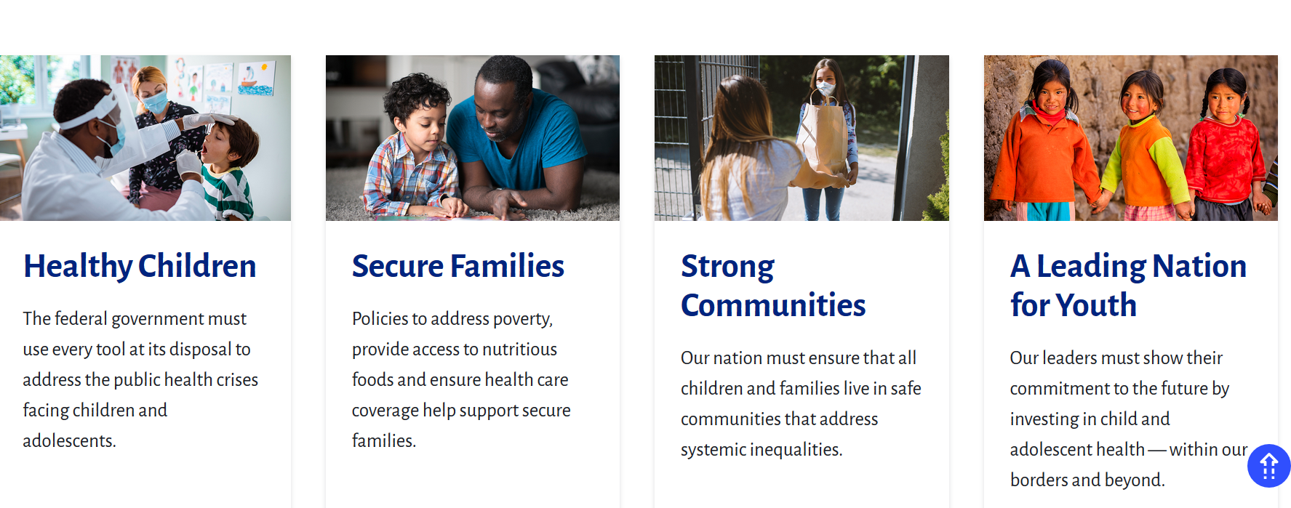
Blueprint for Children
A Child Health Policy Agenda for 2020 and Beyond

Slide 14

Policies that Promote Healthy Children
Protect and strengthen Medicaid, CHIP, ACA
Counter vaccine hesitancy with science
  Include children in COVID-19 vaccine trials
Correct vaccine payment inadequacies
  Extend COVID-19 fiscal relief to all pediatricians
Ensure medical personnel, healthcare workers, first responders, child welfare service providers have tools, funding, PPE to serve vulnerable children
Fund and support provision of health care services to AI/AN children and youth
Expand sexuality education and provide adolescents with access to full range of reproductive health services
Protect young people from tobacco products
Notes:
Protect and strengthen Medicaid, CHIP and the ACA so all from birth to the age of 26 years are covered by an affordable, quality health insurance plan that allows access to comprehensive essential care including mental health.
Promote efforts to help pediatricians assist vaccine hesitant parents in decision-making—countering misinformation with facts about the vital role of vaccines and the number of lives saved by immunizations, sharing science-based vaccine resources, and personalizing evidence to parents based on cultural beliefs and vaccine concerns in a non-confrontational way.
Include children and adolescents in COVID-19 vaccine trials as soon as appropriate
Fund services for children most vulnerable to COVID-19, including youth of color, children with disabilities, justice-involved youth, those in the child welfare system, low-income youth, and children in immigrant families.
Ensure our medical personnel, healthcare workers, first responders, and child welfare service providers have the tools, funding, flexibility, and personal protective equipment necessary to serve our most vulnerable children while ensuring child and caregiver well-being.
Evaluate policies across the government through the lens of racial equity, with the goal of instituting universally just and equitable policies that can eliminate disparities, particularly in health care.
Honor U.S. treaty-based responsibilities and obligations to provide quality health care to the American Indian and Alaska Native (AI/AN) population by robustly funding and supporting the provision of health care services to AI/AN children and youth.
Recognize that healthy children need a healthy pediatric delivery system that doesn’t simply rely on the goodwill and personal sacrifice of pediatricians: bring Medicaid payment rates up to parity with Medicare, correct vaccine payment inadequacies, and extend COVID-19 fiscal relief to all pediatricians.
Meet the growing needs of America’s children with special health care needs by ensuring it is financially viable for pediatricians to pursue subspecialty training.
Protect civil rights protections in health care for all children to ensure that discrimination and personal beliefs do not hinder access to care or perpetuate health inequities.
Foster lifelong sexual health and wellbeing by expanding comprehensive sexuality education and advocating for adolescent access to the full range of reproductive health services.
Protect young people from tobacco products through appropriate product regulation that keeps child-friendly products off the market, effective laws that reduce youth access, and expanded provision of tobacco cessation services for adolescents who have initiated tobacco product use.
Reduce adolescent substance use through expanding evidence-based screening, brief intervention, and substance use treatment services.

Slide 15

Policies that Promote
Secure Families
Improve access to Medicaid
Increase funding/access to federal nutrition programs
Make access to paid family and medical leave universal
Raise minimum wage, offer job training, strengthen tax
credits, cash assistance, SNAP
Expand federal rental assistance, improve and enforce public housing standards to combat housing inequities and environmental racism
Improve child welfare system to give parents economic/social supports, access to mental health and substance use disorder treatment
Ensure TRICARE covers needed services for children who live in military families
Notes:
Improve access to Medicaid by simplifying eligibility processes and enrollment and reducing bureaucratic barriers
Increase funding for and access to federal nutrition programs
Develop/fund alternatives to distribute meals to food-insecure families and maintain access to WIC during school closures
Make access to paid family and medical leave universal
Raise the minimum wage, offer job training, strengthen tax credits, cash assistance, SNAP
Expand federal rental assistance, improve and enforce public housing standards to combat housing inequities and environmental racism
Improve child welfare system to give parents economic and social supports and access to mental health and substance use disorder treatment rather than put children in foster care
Ensure TRICARE covers needed services for children who live in military families

Slide 16

Policies that Promote Strong Communities
Improve quality of education in segregated urban, suburban,
rural communities
Ensure universal access to high-quality early childhood care
Reduce the violence children experience and witness
  Continue/expand federally funded research to prevent gun violence
  Pass measures such as universal background checks and EROs
  Support evidence-based violence prevention programs
Enact policies that promote healthy environments for children and families
Address disparities in access to telehealth such as access to high-speed internet
Bring protections for children online so they have a safe environment to learn and grow
Notes:
Improve the quality of education in segregated urban, suburban, and rural communities
Continue and expand federally funded research to prevent gun violence.
Reduce the violence children experience and witness in their communities through measures to ensure that firearms do not get into the wrong hands such as universal background checks and support the implementation of evidence-based violence prevention programs.
Ensure all children have universal access to high-quality early childhood care and education environments
Enact policies that promote healthy environments for children and families, including reducing air pollution, and protecting children from exposure to harmful chemicals.
Reduce greenhouse gas emissions, transition to a clean energy economy, and promote environmental justice.
Promote access to quality and healthy housing so that children are protected from environmental hazards such as lead, a potent neurotoxin.
Ensure all children have access to clean and safe outdoor recreation areas so that children can play together, participate in physical activity, advance their social and emotional well being and reduce the rates of childhood obesity.
Address disparities in access to telehealth such as appropriate communication infrastructure, especially high-speed internet.
Bring protections for children online into the 21st century so that young people have a safe and developmentally appropriate environment to learn and grow both online and off.

Slide 17
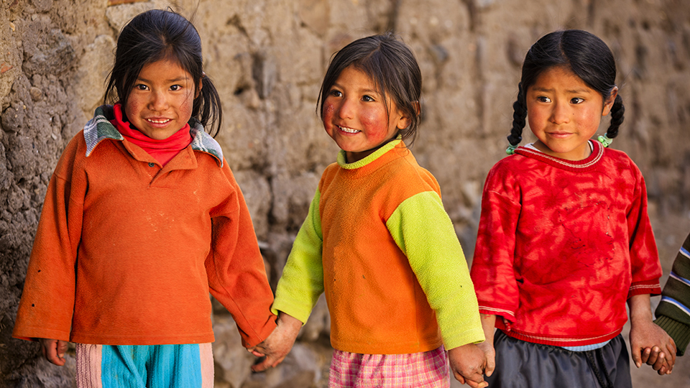
Policies to Ensure Our Role as a Leading Nation for Youth
Implement accessible testing, contact tracing, use of cloth face coverings, physical distancing to stop spread of COVID-19 in schools and
communities
Restore confidence in our public health and scientific
agencies
Enact comprehensive immigration reform that prioritizes
Children’s health and well-being
Prioritize international efforts to address global challenges
by rejoining the Paris Climate Accord and the World Health Organization
Increase foreign aid and strengthen programs that improve children’s health and wellbeing
Expand federal funding for pediatric research
Increase pediatric biomedical innovation/development of next generation therapeutics for children
Notes:
Develop and fund a national strategy to implement the public health measures we know can stop the spread of COVID-19 in schools and communities, including accessible testing, contact tracing, use of cloth face coverings, and social distancing.
Restore confidence in our public health and scientific agencies by reinvigorating their independence from political influence, rebuilding their commitment to evidence-based action, and restoring their role as the first line of defense for public health.
Release all detained immigrant families and end the practice of family detention.
Reunite all separated immigrant families, end the continued, illegal practice of family separation, and provide adequate mental health support for children and families who have been separated.
Reform immigration processing at the U.S. border to protect children’s health and to guarantee the right of immigrant children, and their families, to legal counsel and asylum.
Combat the harmful, xenophobic rhetoric that has further marginalized communities of color and led to poorer health outcomes.
Enact comprehensive immigration reform that prioritizes health, well-being, safety of children.
Prioritize international efforts to address global challenges, such as COVID-19 and climate change, by rejoining the Paris Climate Accord and the World Health Organization.
Increase foreign aid and work to strengthen programs that improve children’s health and wellbeing, end preventable maternal and child deaths, and support all children in reaching their full potential.
Expand federal funding for pediatric research so physicians can better understand children’s health and the diseases that impact them—including COVID-19—and support the career development of pediatric researchers.
Expand pediatric biomedical innovation and development of next-generation of therapeutics for children.

Slide 18
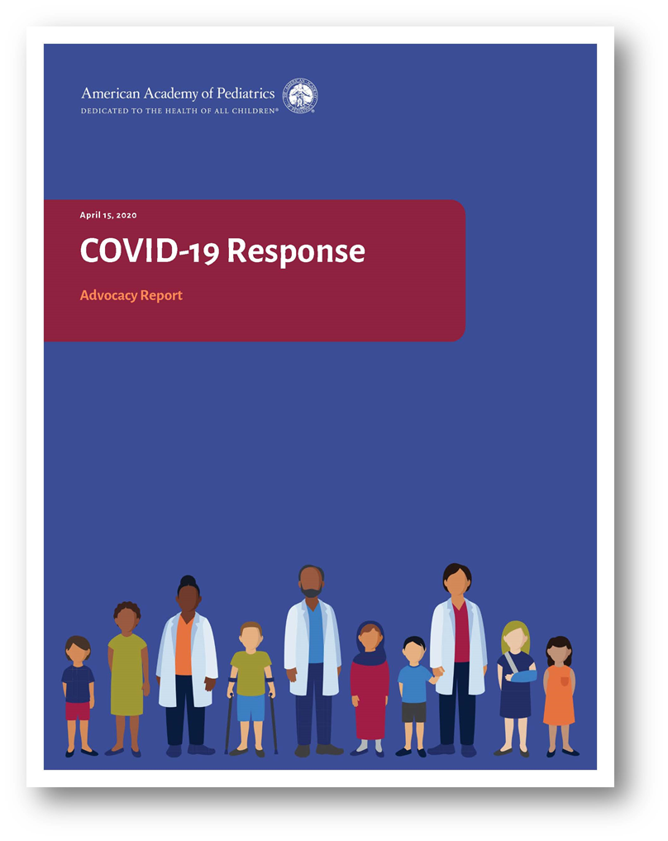
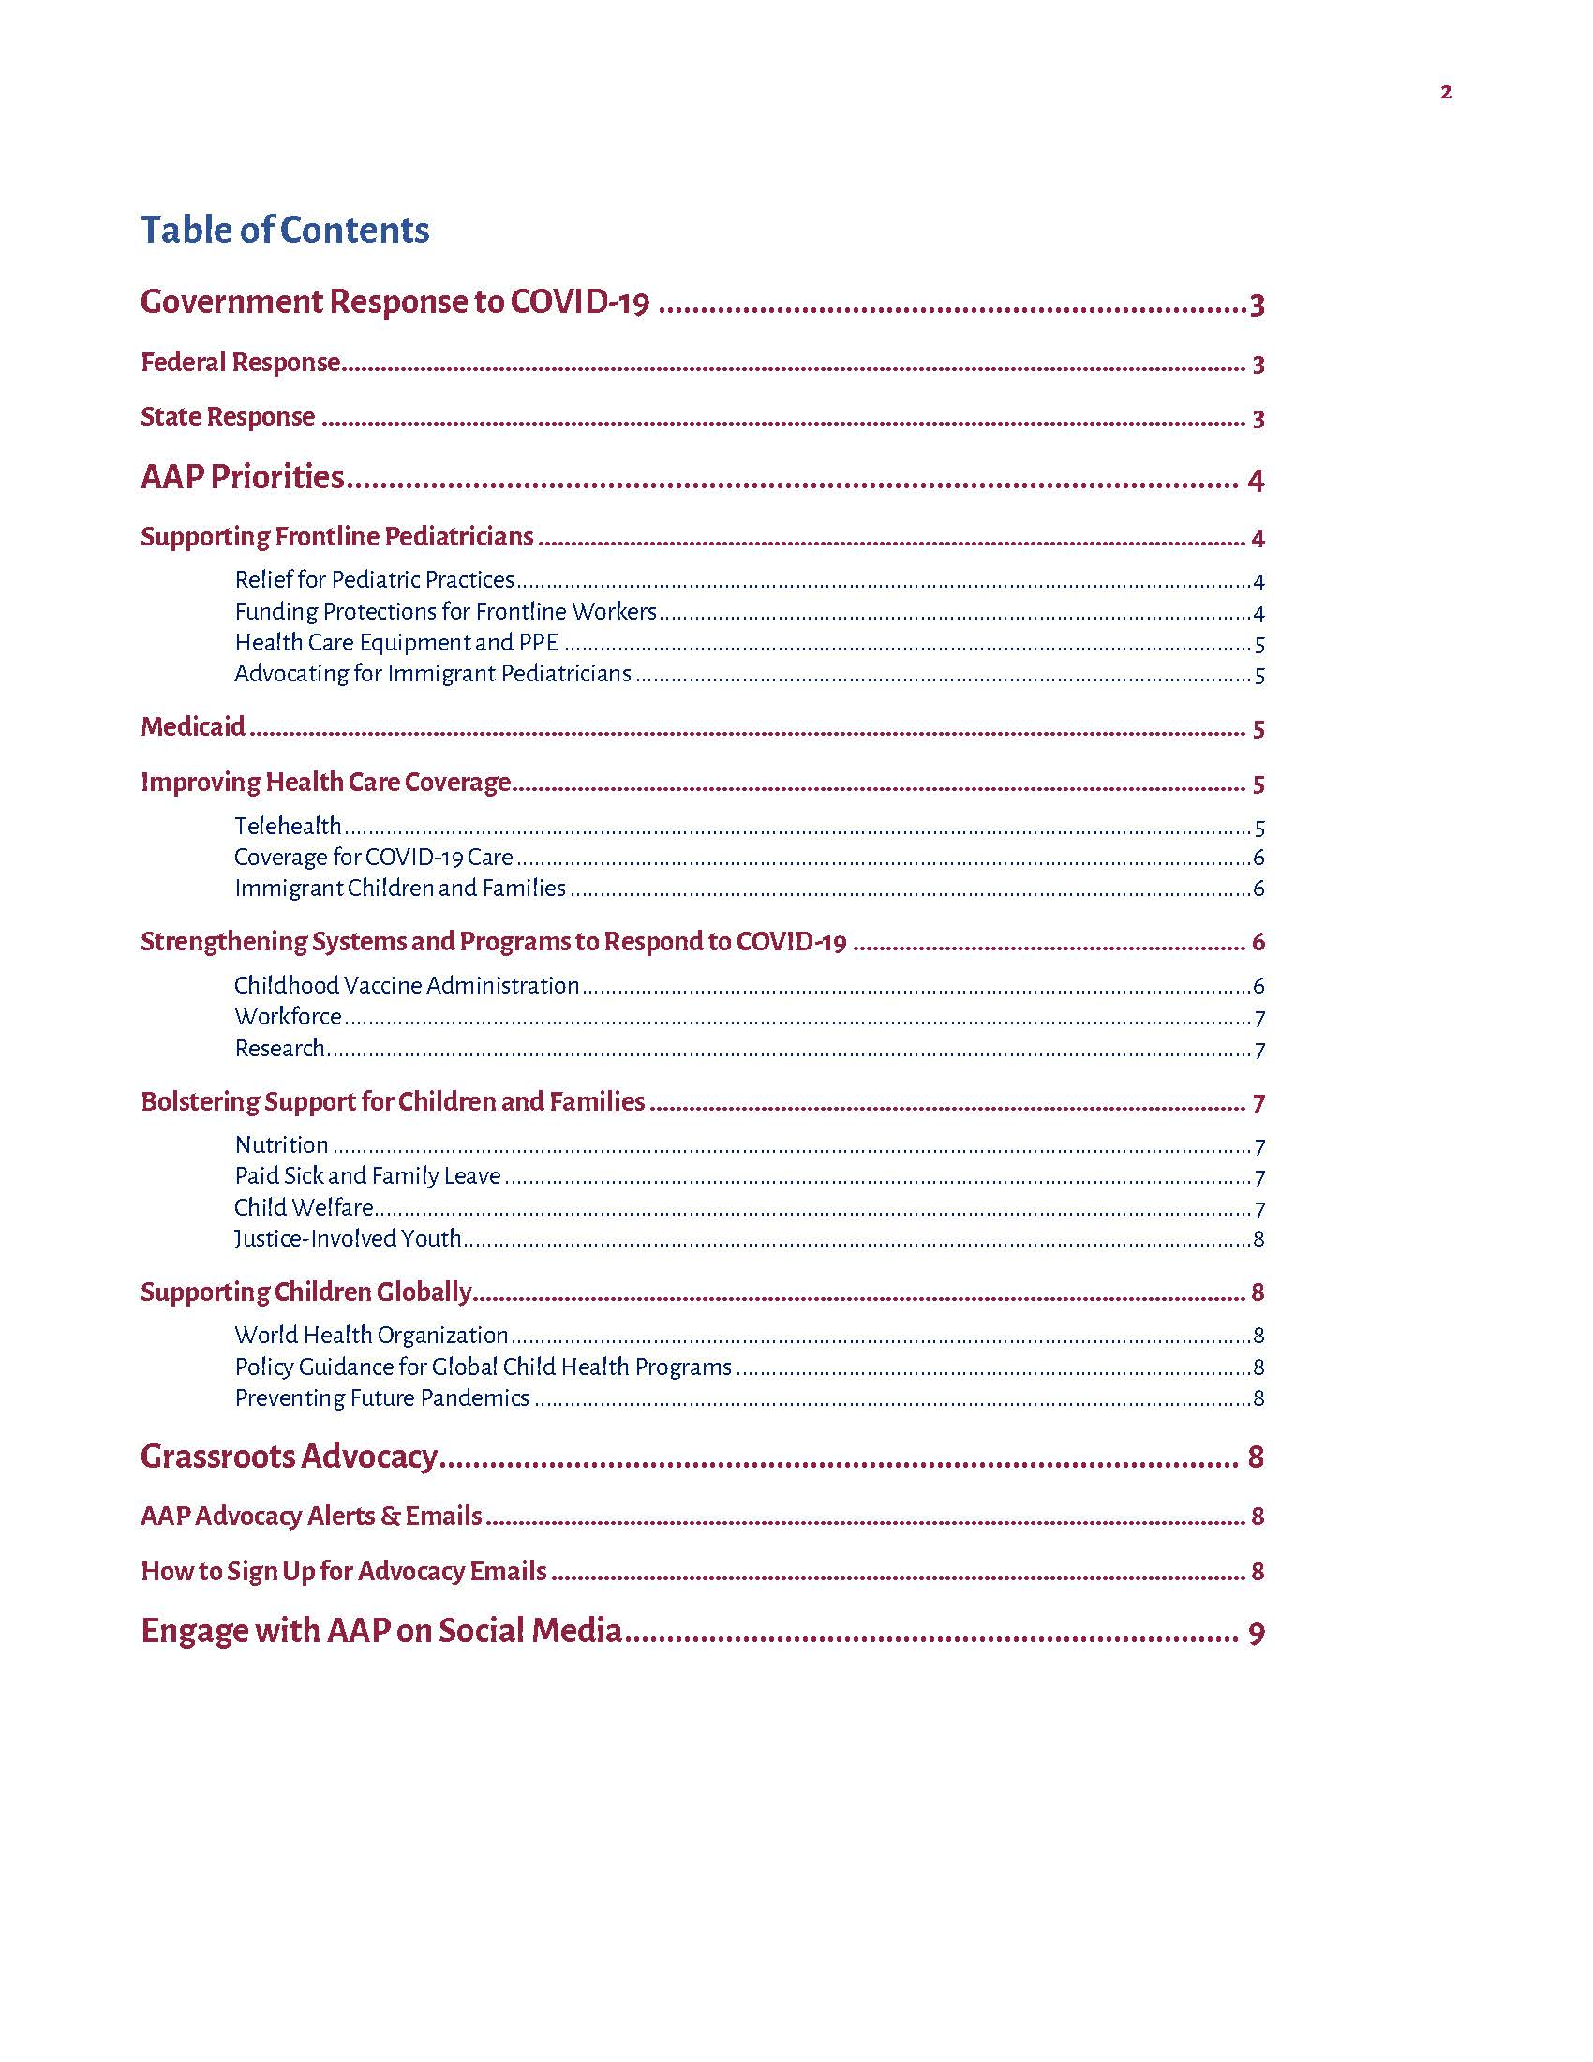
AAP COVID-19 Advocacy Priorities
Supporting frontline pediatricians
Improving health care coverage
  Medicaid
Strengthening systems and programs to respond to COVID-19
Bolstering support for children and families
Supporting children globally
Notes:
In addition to responding to educational needs, we also know it is very important to focus on other systems and practice issue.
Stabilize health care delivery for children by addressing financial hardship among physician practices
Increase Medicaid funding to ensure children and families can get covered during the crisis
Increase vaccination confidence to prepare for a future vaccine for COVID-19
Ensure families have access to nutritious foods while economy recovers
Provide needed medical liability protections for frontline physicians
Protect global health and U.S. security
Provide flexibility and stability for international medical graduates
Support children in the juvenile justice system
Resources to school systems for safe return

Slide 19


Opportunities . . .
Notes:
I’d like to make sure everyone is aware of the new AAP Volunteer Network
The impetus for this came from a 2016 ALF Resolution - Improving Member Access to Leadership Involvement
RESOLVED, that the Academy create and maintain a comprehensive list of open leadership positions at both national and chapter levels that is easy to find on the website and frequently updated.
You can access it from your collaboration sites.
National, chapter and awards, grants and scholarships opportunities can be found here.
This new resource will help ensure we increase transparency about how to get involved in the organization as well as engage new members

Slide 20
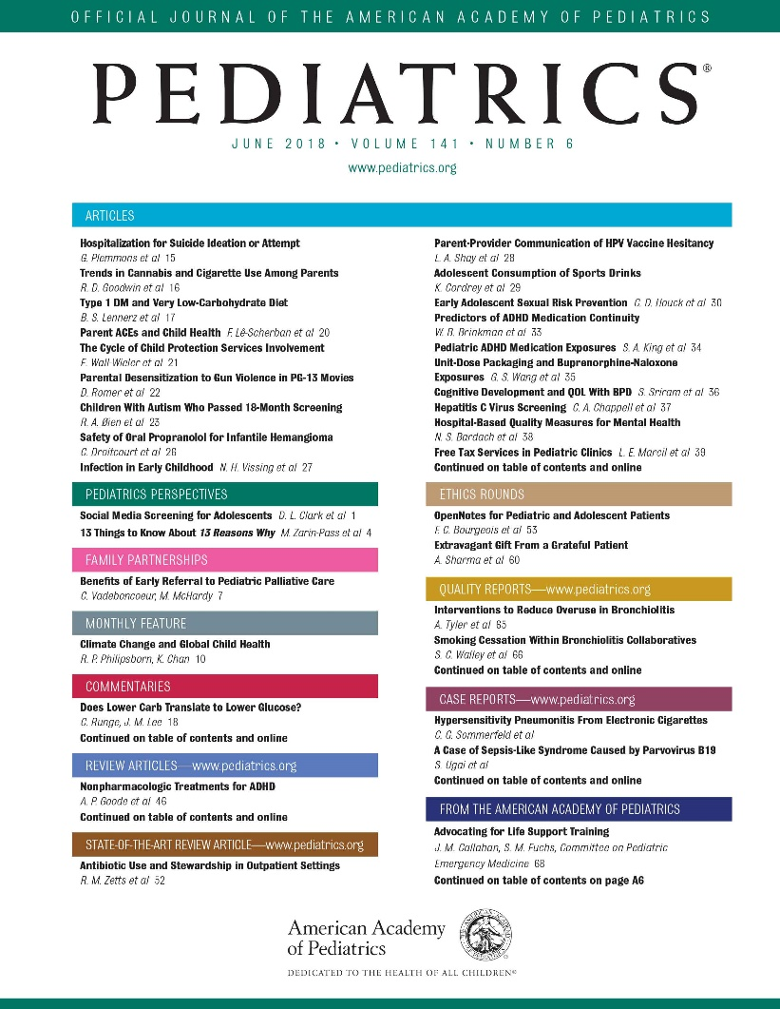
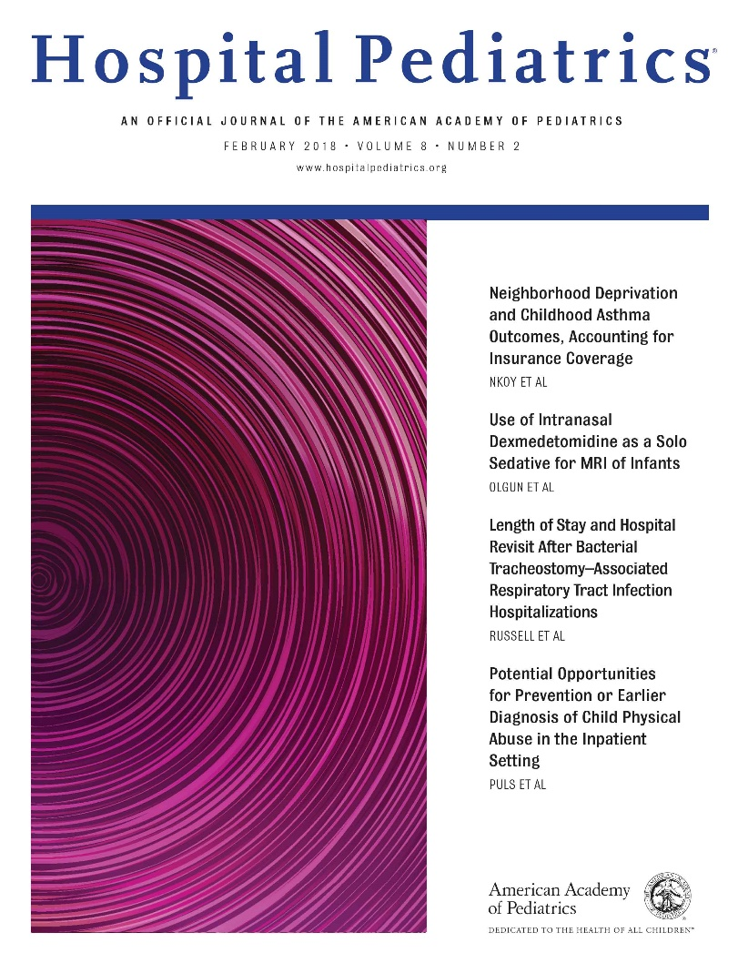

Journal Editorial Boards
Our editorial board nomination calls occur every January/February and are posted on the journal websites

Slide 21

CATCH Grants
Pediatricians and residents with innovative ideas to plan or implement initiatives that address critical child health issues in their communities may apply for $10,000 and $2,000, respectively
Call for Proposals open November 2020 through January 2021
To learn more, visit aap.org/CATCH

Slide 22
Other Training Opportunities
Academic Pediatric Association Health Policy Scholars Program https://www.academicpeds.org/program/health-policy-scholars-program/
Robert Wood Johnson Foundation Clinical Scholars
  https://clinical-scholars.org/
Many others….

Slide 23
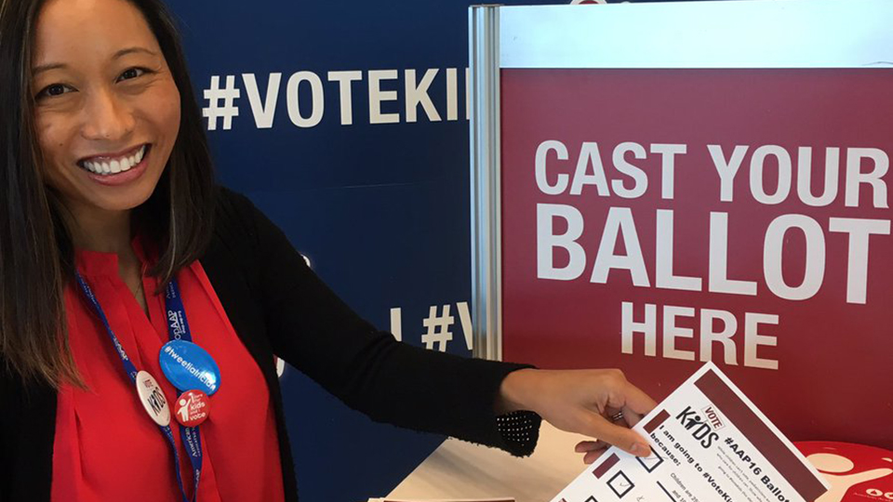
Election 2020: Vote Kids
Focus on equity
Innovative new partnerships
“Healthy democracy” toolkit: vote like your health depends on it
Virtual voting, new ways to engage
aap.org/VoteKids
Notes:
So, don’t know if you’ve heard anything about it but there is this thing called a election coming up.
One of the most important tools we have as child health advocates is our vote, and so we have developed some get out the vote materials focused on prioritizing the needs of children and families.

Slide 24

Thank you!

