Slide 1

Health Advocacy as Scholarship: Making Advocacy Part of an Academic Career
Lee Savio Beers, MD, FAAP
Professor of Pediatrics, Children’s National Hospital
AAP President-Elect
@LeeBeers

Slide 2
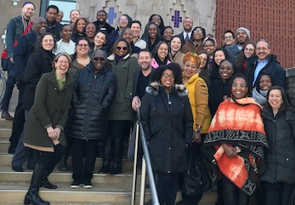
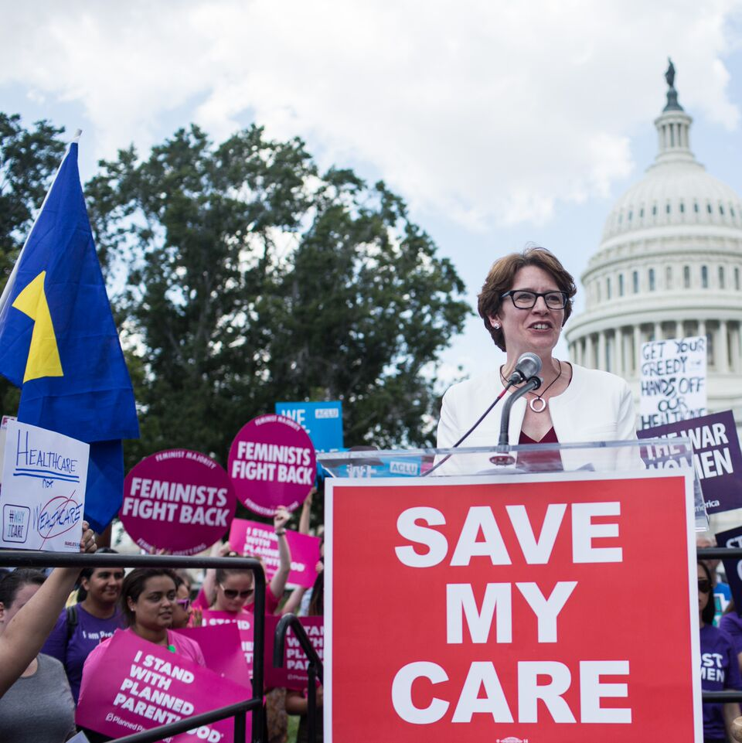
Welcome
Introduce yourself in the chat
  Scholarly and/or advocacy interests and activities
  What you’d like to learn today

Slide 3
The Conundrum of
21st Century
Academic Medicine
CLINICAL PRODUCTIVITY (RVUs)
Education
Advocacy & Service
Research
SCHOLARSHIP

Slide 4
Let’s Review … Criteria for Promotion and Tenure
Varies between institutions, however some common elements
  Research Scholarship (or, “other creative achievement”)
  Teaching
  Service
  Professional
  Institutional
  Clinical
  While most institutions do not have a formal Advocacy Portfolio (yet!), faculty can successfully build their academic portfolio through their advocacy activities

Slide 5
Strategic Planning for Advancement: Requirements Independent of Scholarly Domain
Associate Professor
Clinical excellence
Teaching and mentorship
Professional recognition
Number of grants and publications
Professor
National reputation and expertise
Demonstrated mentorship with outcomes
Professional leadership
High-impact grants and publications

Slide 6
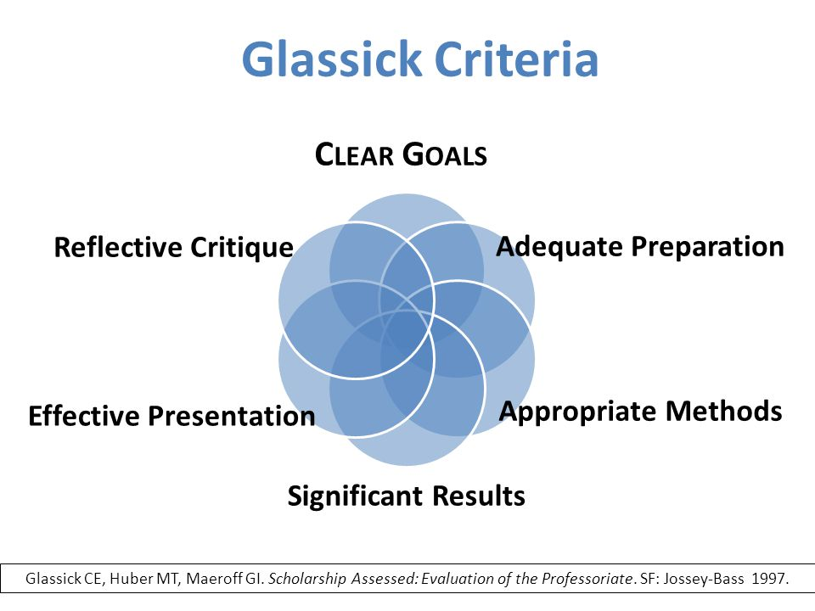
Glassick’s Model of Scholarship
Clear goals
Adequate preparation
Appropriate methods
Outstanding results
Effective communication
Reflective critique

Slide 7
Glassick’s Model of Scholarship Applied to Health Advocacy
Scholarship | Advocacy
Clear Goals | Short- and long-term goals for change in patient and community health
Adequate Preparation | Development of content expertise and relationships to advance goals
Appropriate methods | Planful and strategic approach often using rapid cycle evaluation
Outstanding results | Identify metrics from outset-both process and outcome. Measure what you can, when you can
Effective communication | Audience includes academic, community partners and policy makers
Reflective critique | Learn from unexpected turns and outside influences

Slide 8
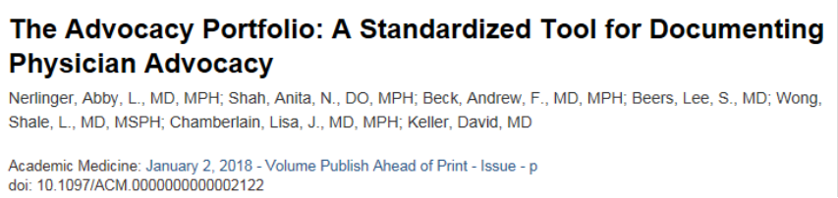
Supporting Faculty Engagement: Advocacy as Part of Your Academic Portfolio
Domains of Advocacy Activities
  Advocacy engagement: Practice or systems level activities
  Knowledge dissemination: To peers, public, policymakers
  Community outreach: Team/collaborative science
  Advocacy teaching and mentoring: Trainees and faculty

Slide 9

How Does this Translate into an Academic Portfolio/Dossier?

Slide 10
Examples of Teaching
Interactive lectures and workshops
Mentorship of trainees or junior faculty
Director of course or clerkship
Curriculum development
Scholarly oversight committees

Slide 11
Examples of Scholarship
Scholarship of discovery
  Intervention evaluation
Scholarship of integration
  Systematic literature reviews
Scholarship of application
  Develop and test innovations in health care
Scholarship of teaching
  Dissemination of curriculum or educational approaches

Slide 12
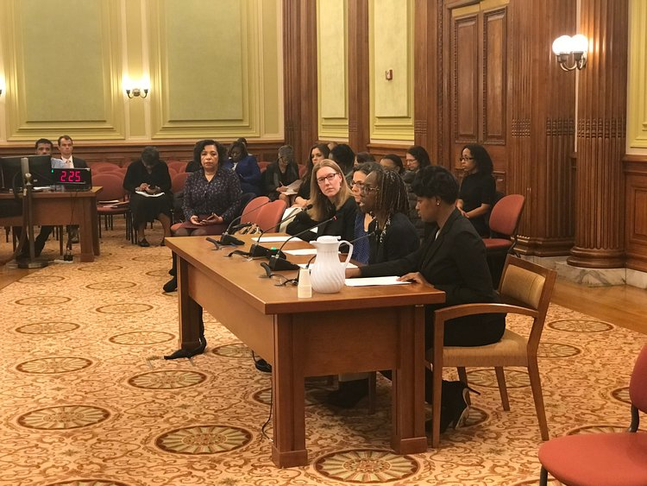
Examples of Service
Consulting as expert with government agencies or health advocacy/policy groups
Leadership in professional organizations
Quality improvement focused on systems of care
Contribution to community benefit
Community or paraprofessional education and training
Media or public speaking to raise profile of institution
Service to profession through education or consultation

Slide 13

Other Considerations
Team science
Personal statements
  Think about your “story” and how it all fits together
Relationship development and networking

Slide 14
Team Science
Per NIH: “…collaborative efforts to address a scientific challenge that leverages the strengths and expertise of professionals trained in different fields.”
Important opportunity for community engagement and recognition
    Shared benefit
    Clear guidelines
Notes:
Discussion of manuscript with Gail
Family Partnership article type in Pediatrics

Slide 15
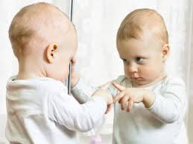
Reflection
What will help you be successful?
What are the barriers?

Slide 16
Keys to Success - Planning
Just as you would for any academic activity, be thoughtful about your goals, methods and desired outcomes
Know your institution’s promotion criteria inside and out
Develop a plan for documenting progress and outcomes
Consider how your activities fit into and support your overall academic career path
Identify mentors

Slide 17
Keys to Success - Learning
Public health and adult education frameworks
Peer and special interest groups
  AAP Community Pediatrics Training Initiative www.aap.org/en-us/advocacy-and-policy/aap-health-initiatives/CPTI
  APA Advocacy Education SIG https://www.academicpeds.org/sig/advocacy-training
  Non-medical literature (e.g. business, non-profit)

Slide 18
Keys to Success - Implementation
Find ways to disseminate your work and achievements, through both academic and lay publications or venues
Seek out leadership and teaching opportunities
Be flexible
Be bold – don’t hesitate to speak up

Slide 19

Ready to dive in?

