Slide 1
THE PEDIATRIC HEALTH SERVICES RESEARCH WORKFORCE Shrinking, shifting, or just feeling lonely?
Alyna T. Chien MD MS
Boston Children’s Hospital / Harvard Medical School
Advanced Pediatric Leaders Program
9 December 2022
Notes:
Mary

Slide 2
Problem
Knowledge generated by population health and health services researchers is a key ingredient in a wide variety of clinical and policy decisions that affect child health and health care
Notes:
ª Population health is defined as “…health outcomes among group of individuals…These groups are often geographic populations such as nations or communities, but can also be other groups such as employees, ethnic groups, disabled persons, prisoners, or any other defined group.” (Kindig D, Stoddart G. What is population health? Am J Public Health. 2003 Mar;93(3):380-3. doi: 10.2105/ajph.93.3.380. PMID: 12604476; PMCID: PMC1447747)
^{b} health services research
population health and health services research draws upon a variety of disciplines: actuarial science, anthropology, biostatistics, clinical sciences, decision theory, demography, economics, epidemiology engineering, ethics, finance, gerontology, geography, health education, history, law, marketing, medical informatics, nutrition, operations research, pharmacy, political science, psychology, sociology, and statistics. (Institute of Medicine Committee on Health Services Research, A WORKING DEFINITION OF HEALTH SERVICES RESEARCH, National Academies Press (US); 1994)

Slide 3
Problem
Pediatric research / researchers / funding generally thought to be on the decline, however
NIH’s RCDC system reports that funding is rising for multiple categories of pediatric research, and
Health services research workforce growing and more demographically diverse than the general adult US population
Notes:
Stiehm, Pediatric Research: National Institutes of Health Support in the ‘Steady-State’ Decade, 1983-1993. Arch Pediatr Adolesc Med 1996;150:971-974; Gitterman, That Sinking Feeling, Again? The State of National Institutes of Health Pediatric Research Funding, Fiscal Year 1992-2010.
Frogner, How the health services research workforce supply in the United States is evolving. Health Services Research 2022.
RePORT (nih.gov)

Slide 4
Problem
Lived experience—child research is conducted by…
Pediatricians in pediatric centers
Non-pediatricians in non-pediatric organizations
Both express a sense of isolation…
Notes:
Stiehm, Pediatric Research: National Institutes of Health Support in the ‘Steady-State’ Decade, 1983-1993. Arch Pediatr Adolesc Med 1996;150:971-974.
Gitterman, That Sinking Feeling, Again? The State of National Institutes of Health Pediatric Research Funding, Fiscal Year 1992-2010.
Frogner, How the health services research workforce supply in the United States is evolving. Health Services Research 2022.
RePORT (nih.gov)

Slide 5
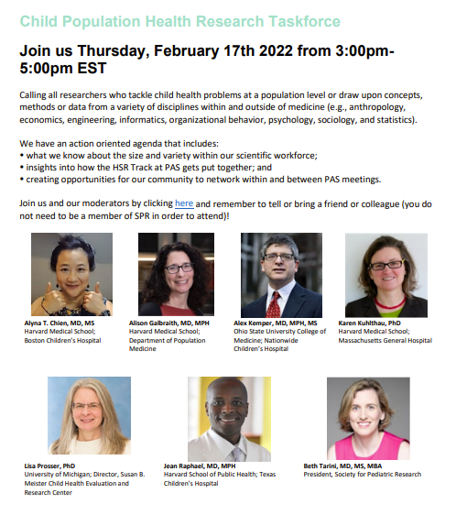
Actions
2021
Q1: Created SPR Task Force on Child Population Health Research
Q2: Recruited Advisory Group
Q3: Liaisoned with DSSCo (decision scientists) and APA Interdisciplinary SIG
Q4: Convened Advisory Group meetings
2022
Q1: Hosted Town Hall and generated ideas for PAS 2022

Slide 6
Results
2021
Q1: Created SPR Task Force on Child Population Health Research
Q2: Recruited Advisory Group
Q3: Liaisoned with DSSCo (decision scientists) and APA Interdisciplinary SIG
Q4: Convened Advisory Group meetings
2022
Q1: Hosted virtual networking event #2
Q2: Hosted PAS’22 CPHR/HSR events:
• 17th Annual Reception
• Inaugural Networking Session
Q3: HSR Scientists added to:
• SPR Executive Council
• PAS Program Committee
• Abstract Review Committee HSR Track
• Workshop Review Committee
Q4: Host virtual networking event #3
2023?
Q1: Decide topic/issue/activity for virtual networking event #4 (?PAS 2023)
Q2: How will PAS’23 go?
Q3: • How will junior/senior mixer go?
• Will we double # of abstract submissions?
• Will we increase the abstract acceptance rate?
• Will abstract empanelment create more meaningful conversation?
• Will panels have moderators that will encourage networking?
• Will more engaged in the group?
Q4: Decide topic/issue/activity for virtual networking event #5 (?pipeline/succession planning)

Slide 7
THE PEDIATRIC HEALTH SERVICES RESEARCH WORKFORCE Shrinking, shifting, or just feeling lonely? Unshrinking, shifting, and getting less lonely?
Alyna T. Chien MD MS
Boston Children’s Hospital / Harvard Medical School
Advanced Pediatric Leaders Program
9 December 2022
Notes:
Mary

Slide 8
Please take a moment to provide Feedback for Alyna Chien

