Slide 1


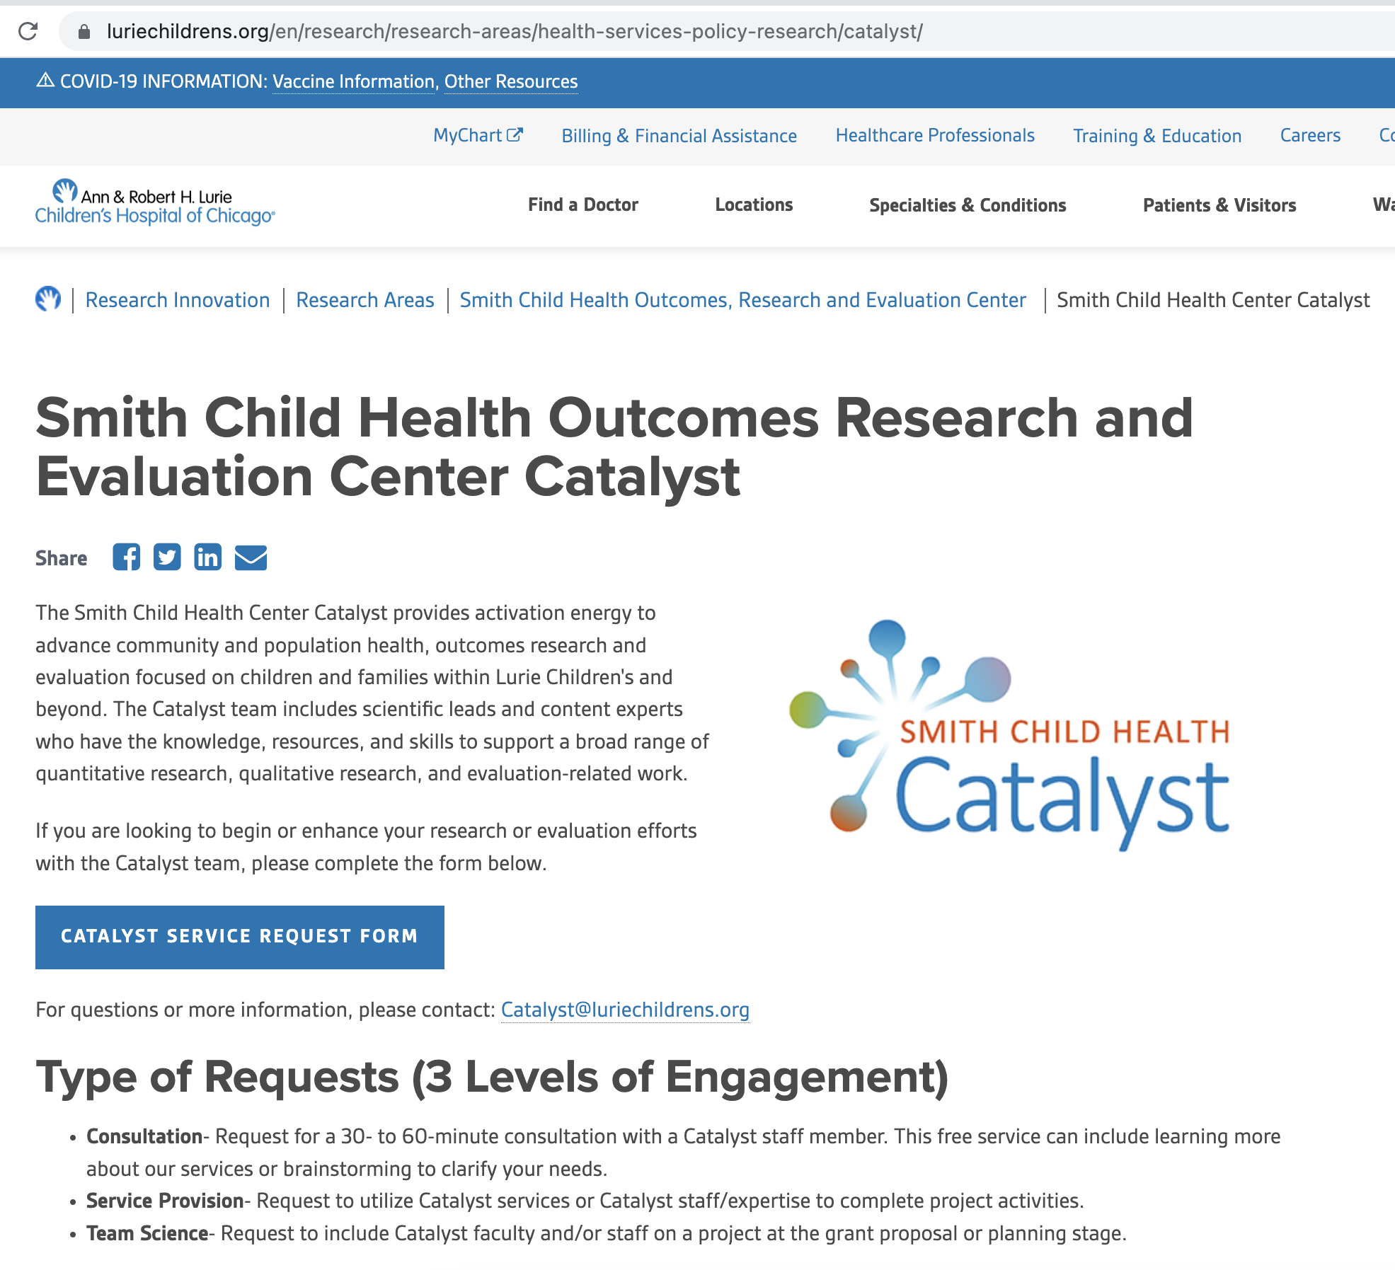
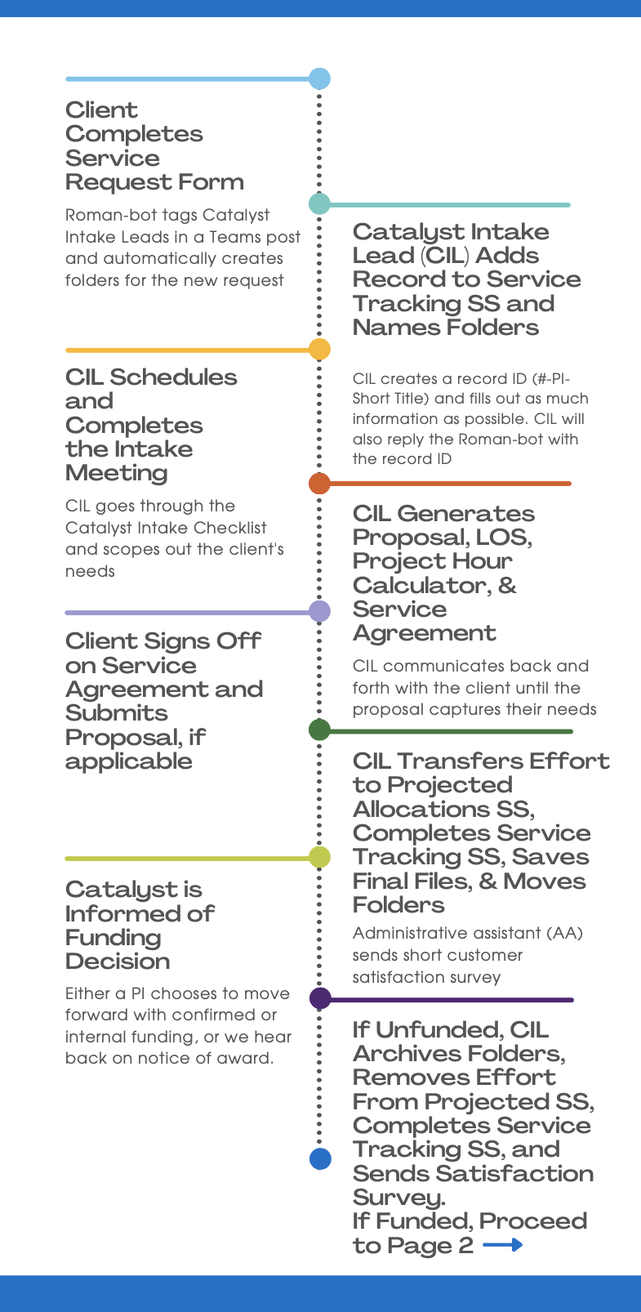
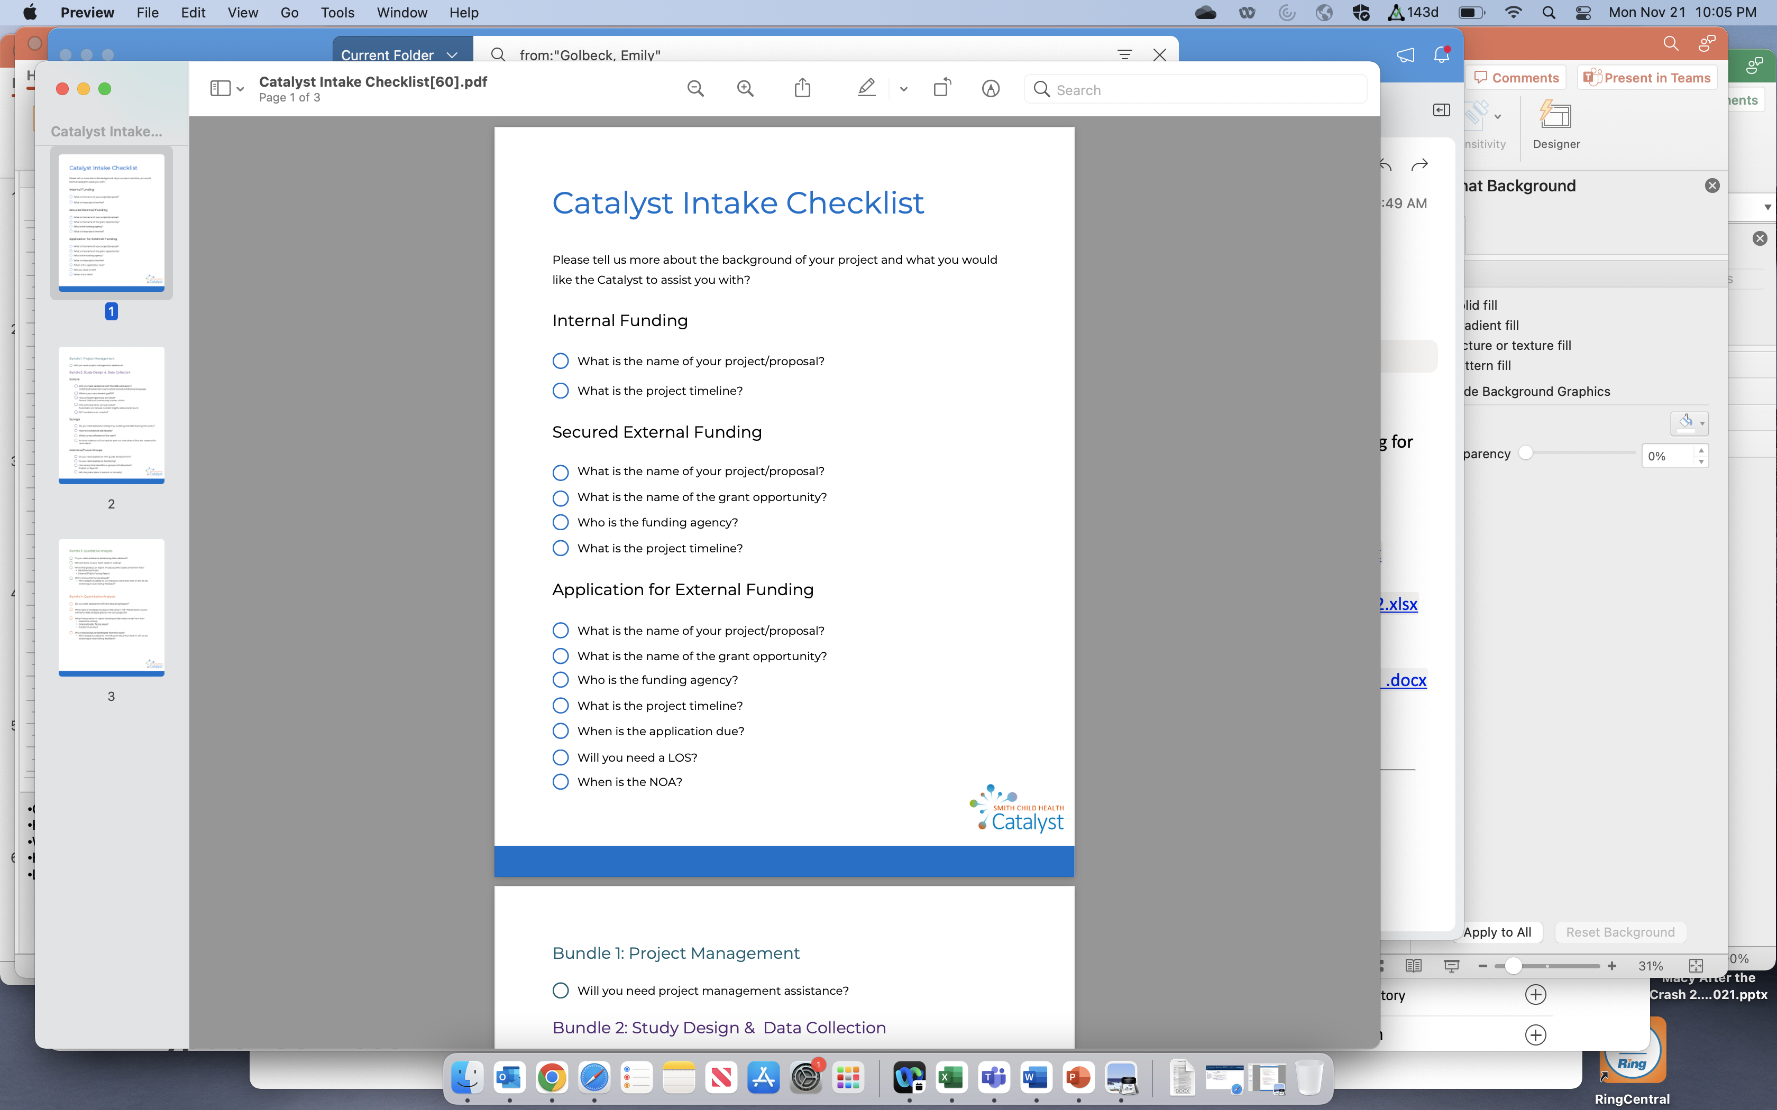
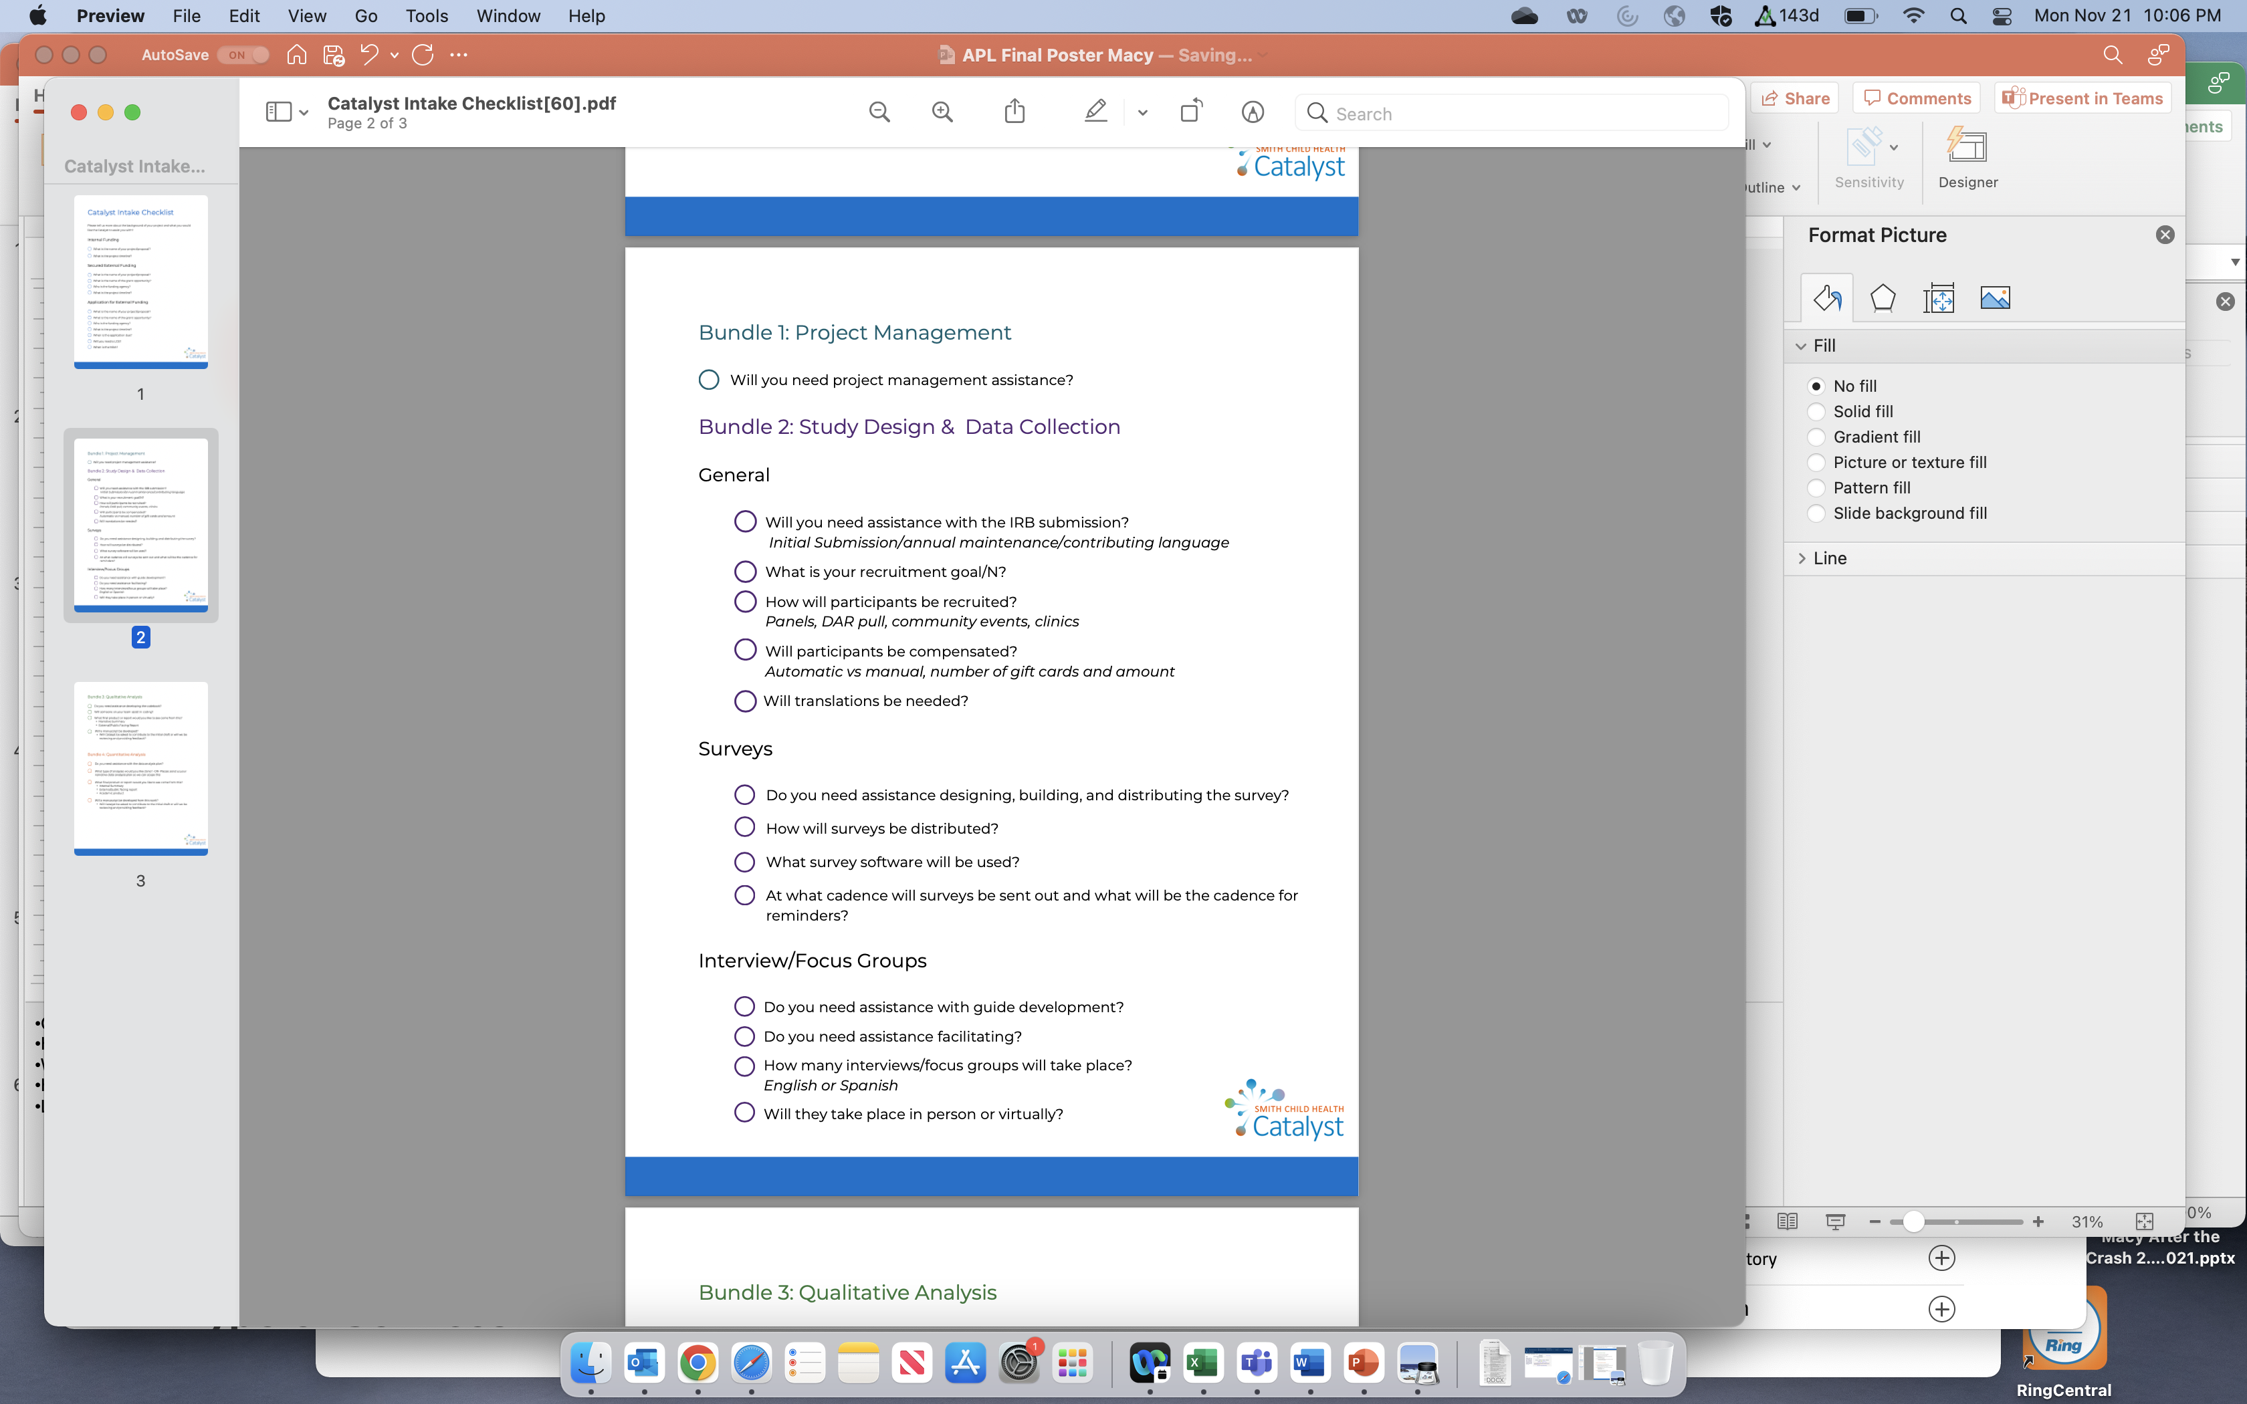
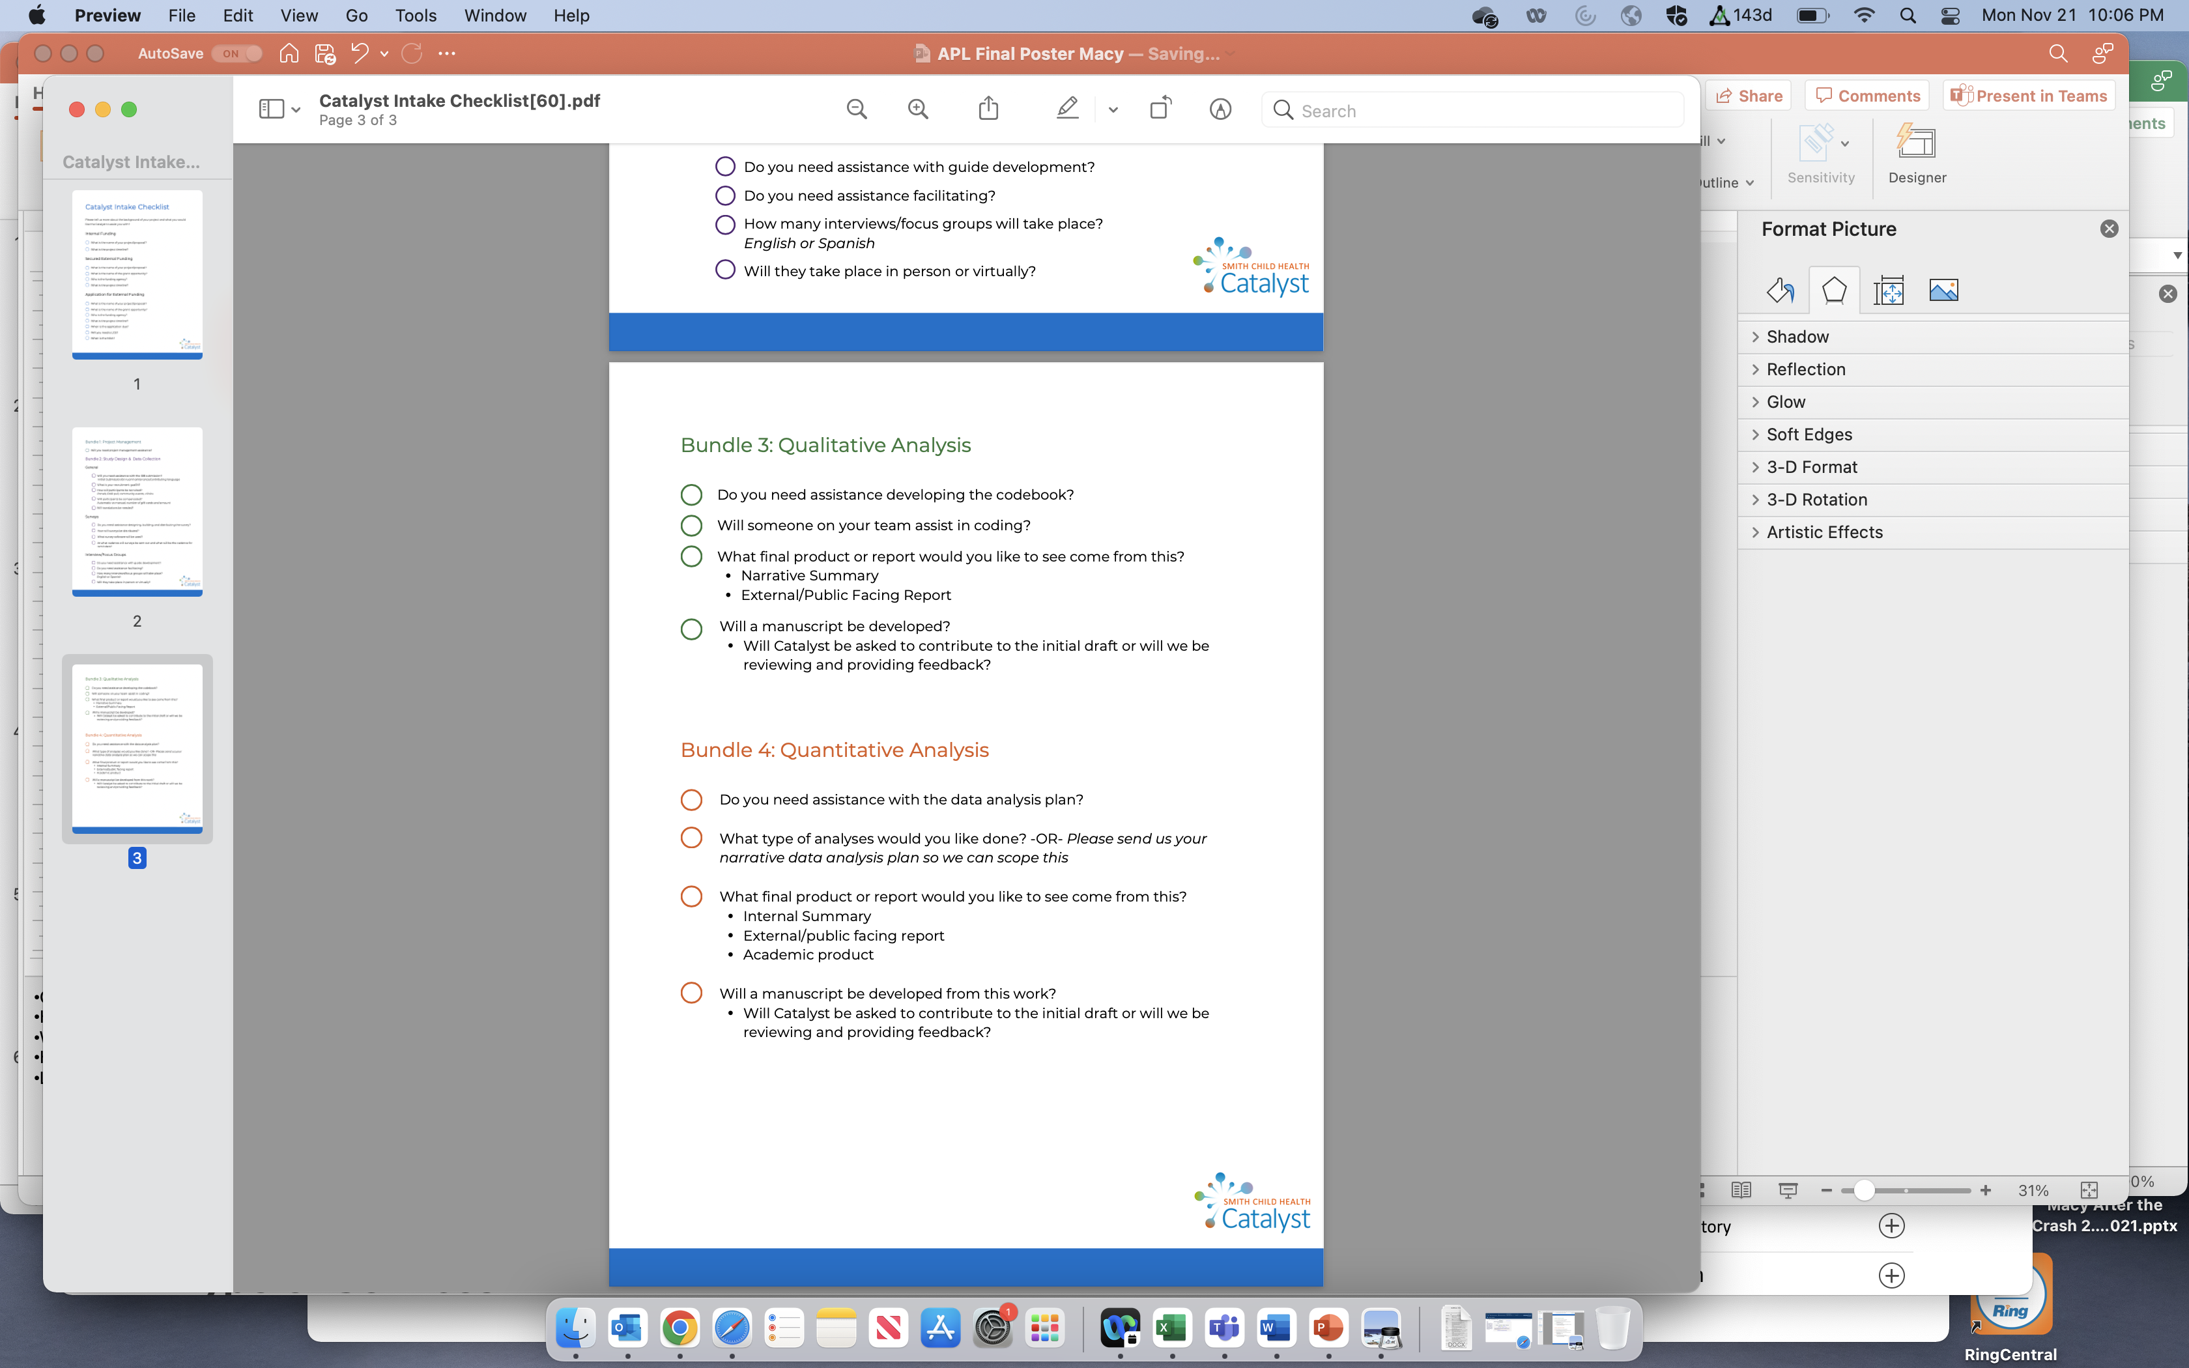


Supplying Activation Energy for Social, Behavioral, and Population Health Research and Evaluation:
The Smith Child Health Catalyst
Michelle L. Macy, MD, MS
Background
Methods/Changes Implemented
Core facilities support basic science
  Facilitates research activities
  Fosters collaboration
  Financial stability - fee for service
Behavioral and social science supports were lacking
  Under resourced projects
  High staff turnover
Unique skill sets
  Qualitative and quantitative data collection, mixed methods analysis, patient, family, provider engagement
Program Launch
  June 2021
Starting Team
  Associate Director
  4 Scientific Leads
  3 Research Professionals
Website
  Electronic request form
Cost Center
  Revenue model with rate billing
SOPs and Templates
  Intake checklist, budgeting, service proposal, letters of support
Outcomes/Results Achieved
150 Requests for Service
  56 Consultation
    32 Divisions
  60 Service Provision
    21 Divisions
  30 Team Science
    15 Divisions
Higher yield on grants
Team Growth
  2 Project Managers
  6 Research Professionals
Goals/Objectives
Next Steps for your project
Provide behavioral and social science research infrastructure
Enhance competitive grant submissions
Stabilize workforce
Pilot digital tools to increase efficiency
Refine processes
Measure productivity
Advertise/market
Project future growth
Notes:
Challenges faced during project and how you overcame them
How you have changed as a leader as a result of the program/your project work
What new leadership practices you have employed
How the program has been most helpful
Leadership pearls that you have learned to share with others

Slide 2
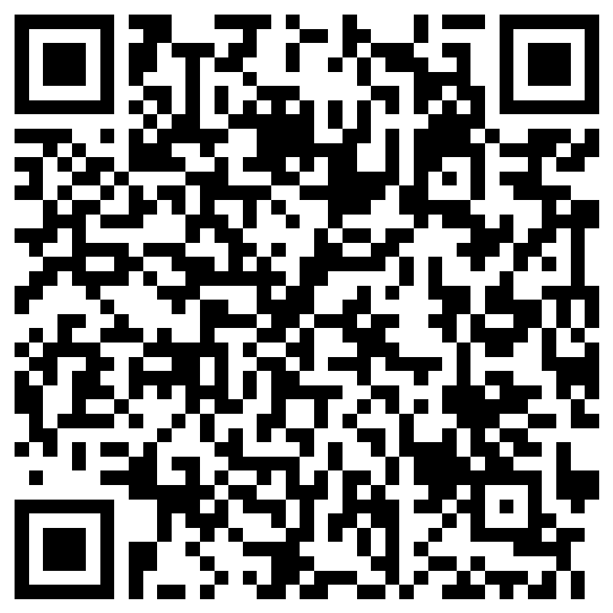
Please take a moment to provide feedback to Michelle Macy

