Slide 1
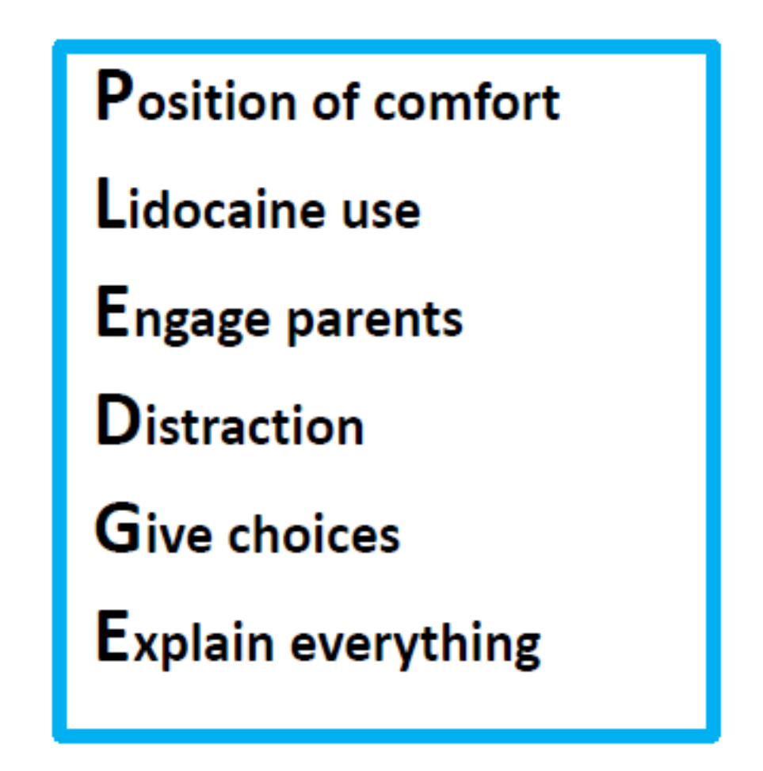
A Winding Journey Cara Haberman MD
Wake Forest University
School of Medicine
Where it Started
Challenges
A New Vision
Clinical Improvement Project:
Reduce distress experienced by patients and families in the hospital by utilizing evidence-based strategies to minimize procedural pain and anxiety
Structured
Dyad Mentoring
Program
Departmental
Development
Sessions
Difficulty in obtaining data for process and outcome measures
Covid restrictions, work hours and expectations of Child Life Team
Nursing concern about utilizing lidocaine cream
Became Vice Chair for Faculty Development a few months prior to APL
Spring 2021 decided to transition out of Medical Director role to focus more on VC role, stepped down Fall 2021
Career-Stage
Group Mentoring
Added support
for Promotions
process
Needs Assessment
Outcomes/Results
Lessons Learned
65 responses out of ~95 faculty
35 had mentors/30 seeking mentors
3 faculty accounted for >40%
of mentorship
Record number
of applications
for promotion
this year
New leadership opportunities
Co-Chair of Dept P&T
Chair of several
institutional committees
on faculty development
Tasked with revamping
women’s career development
and leadership programs
Stepping away from things feels a lot better when used as an opportunity for sponsorship
Dr Dennis Kuo: “Leadership is giving away power”
Leading change is always difficult; it’s made easier when you lead with your heart and your passion
Dr Mary Ottolini: “Life is too short. Talk about what you love”
Group Mentoring
model adopted
by institution
1/3 of department participated in
structured mentoring in 1st year

Slide 2
Please take a moment to provide feedback to Cara Haberman

