Slide 1
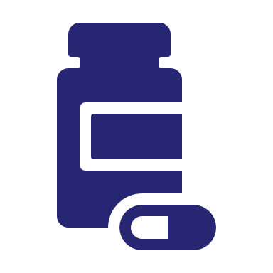
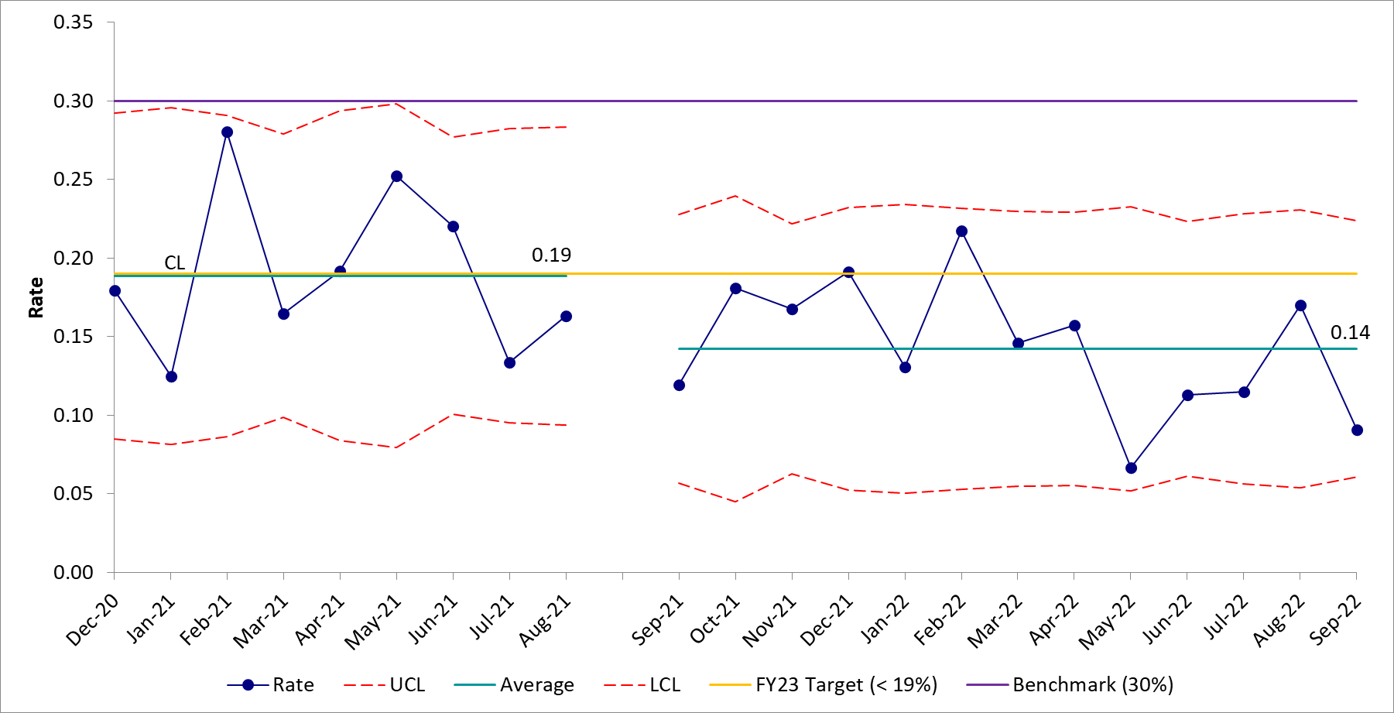
Developing, Deploying, and Sustaining an Outpatient Antimicrobial Stewardship Program Hayden T. Schwenk, MD, MPH Stanford School of Medicine and Stanford Medicine Children’s Health
Background
Methods/Changes Implemented
Next Steps
Antibiotics are the most common prescription for children and most are prescribed for outpatients.
Create guiding coalition
ASP
Pharmacy leadership
Create/Communicate vision
Collect baseline antibiotic utilization and appropriateness data
Early wins
Audit & feedback of discharge prescriptions [09/21]
Hospital leadership
Primary care network leadership
Outpatient and home pharmacy
Outpatient subspecialty clinics
ER physicians, nurses, and pharmacists
Disseminate and discuss antimicrobial prescribing data with key stakeholders
Prioritize work → hospital discharge prescriptions
Optimization of EMR-based clinical decision support [12/21, 02/22]
Development of specialty- and condition-specific guidelines [03/22, 05/22, 07/22]
Iterate discharge prescription review process to improve efficiency and impact.
Operationalize additional interventions to improve discharge prescribing.
Expand ambulatory ASP efforts into new areas.
Overuse/Misuse of antibiotics leads to ↑ resistance, costs, and adverse drug reactions.
Antibiotic stewardship programs (ASP) improve outcomes & ↓ harm by optimizing antibiotic rx.
Our ASP has ↓ inpatient broad-spectrum antibiotic use by >25% & antimicrobial spend by >$3 million.
There are significant gaps in ambulatory antimicrobial stewardship.
Objectives
Outcomes/Results Achieved
Describe current state of antimicrobial prescribing in each of the 4 ambulatory environments (i.e., ER, hospital discharge, subspecialty, and primary care).
Develop a plan for antimicrobial stewardship in each of the 4 ambulatory environments.
Specific objective
Roll-out first ambulatory antimicrobial stewardship intervention by July 2022.
Published literature suggests ~30% of discharge antimicrobial prescriptions are suboptimal (i.e., drug choice, dose, frequency, route, or duration).
Pre-intervention suboptimal discharge antimicrobial prescribing rate (avg) = 19%
19% selected as FY target
Post-intervention suboptimal discharge antimicrobial prescribing rate (avg) = 14%
5% absolute reduction
25% relative reduction
in suboptimal prescribing
Acknowledgments
Members of the SCH ASP including Lauren Puckett, PharmD, BCIDP; Laura Bio, PharmD, BCPS, BCIDP; Torsten Joerger, MD, MSCE; and, Sean Cornell

Slide 2
Please take a moment to provide feedback for Hayden Schwenk

