Slide 1
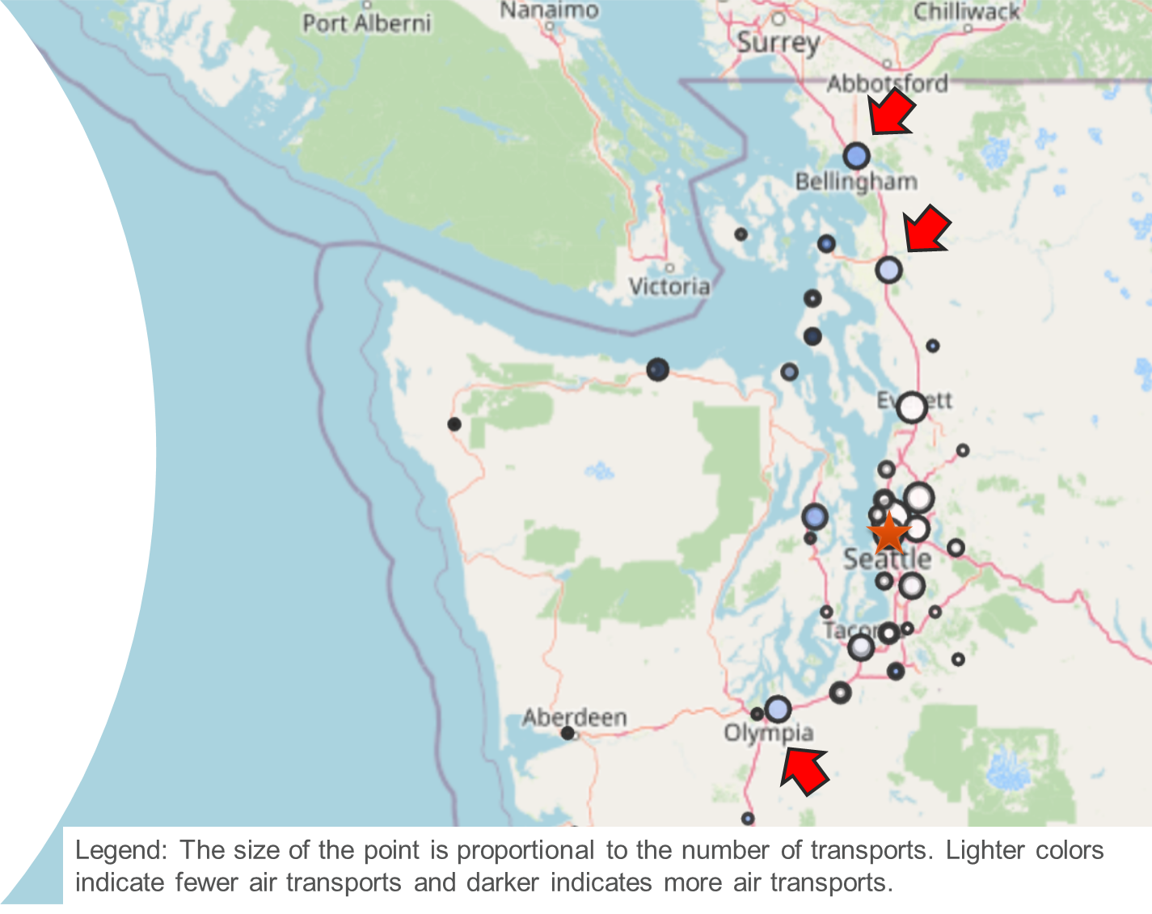
Expanding Neonatal Telehealth Care to Community Hospitals Rachel A. Umoren MBBCh, MS University of Washington & Seattle Children’s Hospital
Background
Changes Implemented
Active Telehealth Sites
Telehealth impacts the quality of neonatal care.
Newborn teleconsultations were less likely to result in a transfer compared to telephone consultations (Haynes et al., 2020).
Neonatal teleresuscitation can result in cost-savings of up to $1.2 million per year from reduced transfer rates.
NICU sites identified by historical consult/transport volumes.
Contracts and delegated privileges for neonatal telehealth services established at three Level II NICUs.
FTE support for neonatologists to provide 24/7 coverage.
Reports from Oct 1, 2021-Sept 30, 2022, tracked session frequency, duration, documentation and transfers.
QI efforts on teleconsult activation and documentation.
10-member Core Team
Administrative
(Division Administrators, Telehealth program administrator)
Clinical
(Neonatologists and neonatal APPs)
Legal
(Contracts, Credentialing)
Compliance/Billing
(Documentation/Coding)
QI reports
(Epic analyst)
Skagit Regional Hospital, Mt. Vernon, Washington (Go-live August 2021)
Providence St. Peter’s Hospital, Olympia, Washington (Go-live April 2022)
St. Joseph’s Medical Center, Bellingham, Washington (Go-live Sept 2022)
Goals
Establish neonatal telehealth support for Level II NICUs in the Pacific Northwest region
Objectives
Telehealth Implementation
Next Steps
Establish 24/7 neonatal telehealth service
Provide telehealth consults to three level II NICUs in Washington state by December 2022
Video data (n=294)
Median call duration 7 minutes (IQR 1-16).
Longest call duration was 3.4 hours.
Survey data (n=108)
14 neonatologists reported median 22 minutes (IQR 15-34) per session
82% of sessions with 1-2 patients
Participated in multi-site research study on neonatal telehealth with 2 publications.
Parents or caregivers were present in 40% of sessions and engaged “as though I was there in person”.
Obtain administrative support
Track quality metrics
Track provider and family satisfaction
Track division revenue from contracts and fee-for-service billing.
Track referral volumes and transports prevented
Expand telemedicine services in other disciplines.
Telehealth Services
Telerounding (38%)
Teleconsults (60%)
Teleresuscitation (2%)
Methods of Transformational Change
Sense of urgency
Guiding coalition
Articulating and Communicating the mission
Celebrating early wins
Scan for
patient story
n=109
ACKNOWLEDGEMENTS: Jack Salerno, Ujiro Okiomah, Maneesh Batra, Jennifer Taylor, Parimal Deodhar, Mara Kelley, Brooke Jardine, Jose Perez, Craig Jackson, Jake Hawksworth, Megan Gray, Taylor Sawyer, Christine Cooper, Kendra Smith, Robert Niimi, Marisa Harvey, Amanda Stiffler, Jasmine James, and the Seattle Children’s Neonatal Telehealth Team.

Slide 2
Please take a moment to provide feedback to Rachel Umoren

