Slide 1
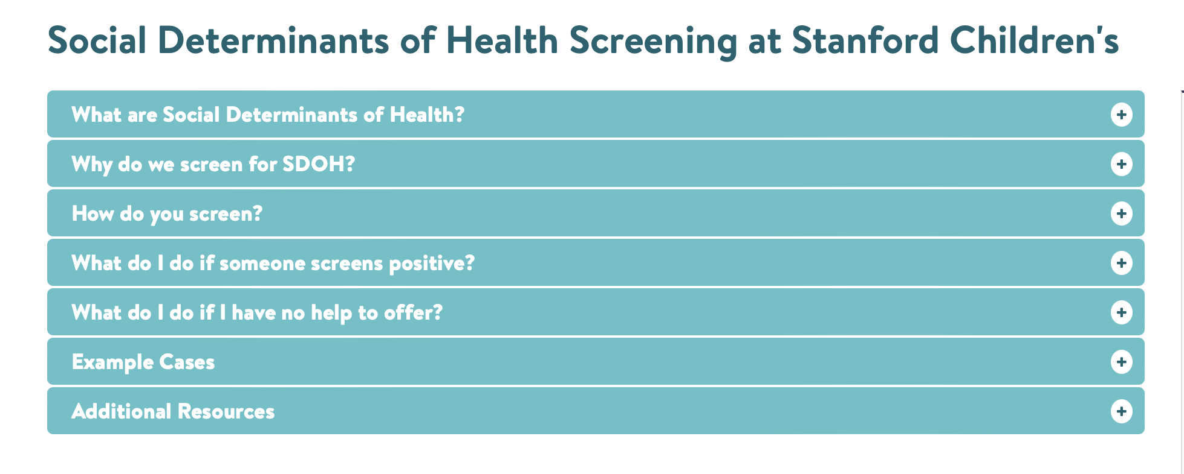
EPIC-Integrated Social Determinants of Health Screening Author(s): Baraka Floyd, MD, MSc and Lindsay Stevens, MD Sponsors: Mary Leonard, MD, MSCE and Lee Sanders, MD, MPH
Background
Methods/Changes Implemented
Outcomes/Results Achieved
Social determinants of health (SDoH) affect health outcomes
Screening for and addressing SDoH recommended by the American Academy of Pediatrics
Children with special healthcare needs have increased SDoH needs
Academic health centers positioned to improve health outcomes for CSHCN served at their centers
Context specific barriers exist to addressing SDoH in pediatric care
Convened physician stakeholder groups across enterprise
Partnered with Office of Child Health Equity to expand resource database from primary care clinic to catchment area
Piloted SDOH training with residents
Multidisciplinary SDOH steering committee convened to guide work
Designed updated SDOH training to meet stakeholder needs, including simulated screening videos
Soft launch EPIC food insecurity screening Aug 2022
Food Insecurity Training Module completed and available
Three sample screening encounters recorded
Web based FAQ completed
Food Insecurity committee convened: local food bank network, Office of Child Health Equity team members, community benefits, members of SDOH steering committee collaborating to respond effectively to needs
EPIC-Integrated Food Insecurity screening soft launch August 2022
Next Steps for your project
Goals/Objectives
Evaluate Food Insecurity Training Module
Continue collaboration with SDOH steering committee as soft launch teams test workflows
Enhance Food Insecurity Training Module as needed prior to full launch of EPIC-Integrated Food Insecurity Screening
Repeat process for additional determinants to support phased roll-out, as enterprise works to build capacity
Expand hyper-local resources to enterprise catchment area
Identify stakeholder needs
Create workforce training modules and tools

