Slide 1
Enhancing a Clinical Coaching Program for 3rd year Medical Students John Darby, MD
Background
Methods/Changes Implemented
Outcomes/Results Achieved Continued
Wake Forest School of Medicine created an MS3 Clinical Coaching program in 2016 to address the need for direct observation on the clerkships
Clinical coaching can help learners reflect on their performance and advance their clinical skills (include reference)
Opportunities existed to standardize and expand the program to new settings and incorporate coaching best practices.
Expanded the clinical coaching program to a new regional campus and developed a strategic restructuring plan to expand the program to all clerkships and incorporate longitudinal coaching relationships
Formed a group of Head Coaches representing the clerkships and developed a Clinical Coaching Canvas website
Integrated Coaches into grading of summative clinical skills assessment events (CPX aka OSCE)
Implemented onboarding for new coaches
A new Canvas page served as a repository for coaching materials and literature.
Trained all 31 faculty on standardized clinical skills assessments ensuring timely completion of grading
Onboarded 5 new clinical coaches at Winston Campus including training on coaching best practices.
Next Steps for your project
Goals/Objectives
Outcomes/Results Achieved
Continue efforts to expand coaching to all clerkships and incorporate longitudinal relationships
Transition the program to new leadership including:
Create a transition timeline
Inform key stakeholders of transition
Assist in identification of a new director
Organize and handoff existing materials
Restructure the coaching program to include coaching on all clerkships and at a new regional campus while promoting longitudinal coaching relationships
Develop increased interaction and community among MS3 Clinical Coaches
Integrate coaches into grading of summative clinical skills assessments
Develop coaching techniques through structured faculty development
Recruited 6 new clinical coaches at our regional Charlotte campus
Developed a strategic restructuring plan and presented to medical school leadership
Recruited 7 Head Coaches and held monthly meetings to share ideas, review best practices, and give informal feedback of the program.

Slide 2
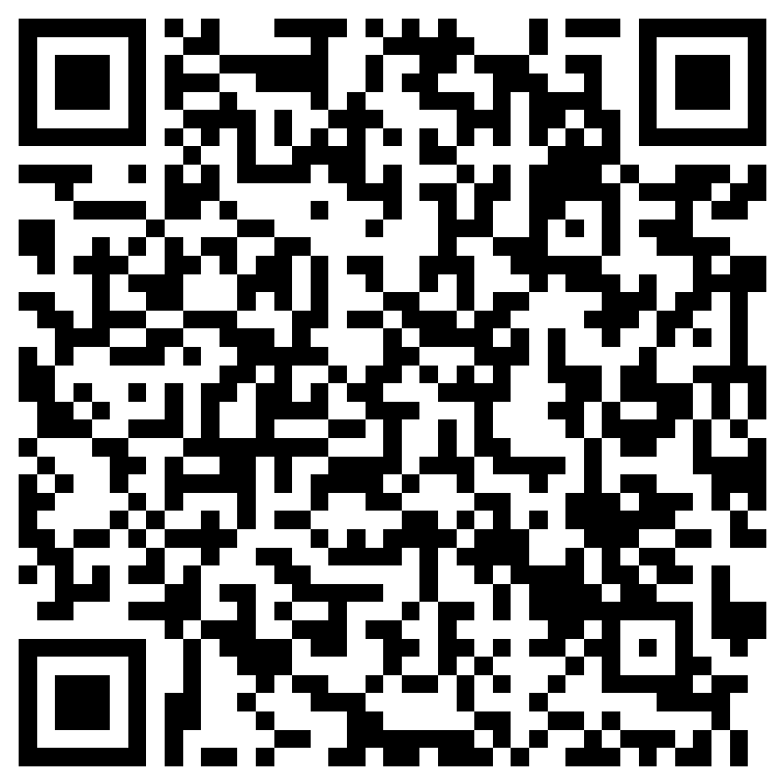
Please take a moment to provide feedback to John Darby

