Slide 1

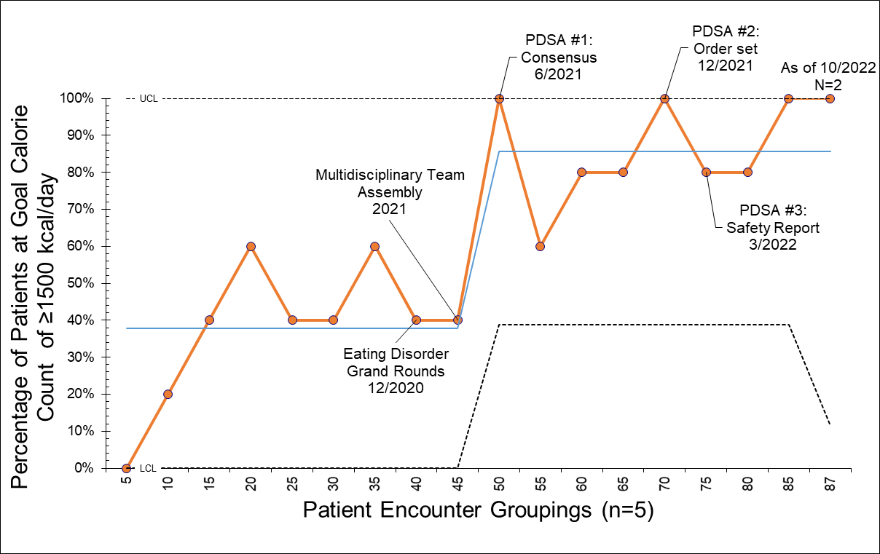
Safe Implementation of Evidence-Based Nutritional Rehabilitation for Hospitalized Adolescents with Eating Disorders
Joanne Mendoza, MD, Miyabi Saito, BS¹, Andrew Burns, MD^{1,2}, Kelsey Berry, MD² , Susan Gray, MD^{1,2}, Eva Manthe, RDN, CSP², Julia Taylor, MD^{1,2}
1. University of Virginia School of Medicine 2. University of Virginia Children’s Hospital
Institution
UVA→ CHKD/EVMS
Background
Methods/Changes Implemented
Next Steps for your project
Adolescent mental health has worsened internationally during the COVID-19 pandemic^{1,2}
Prevalence & severity at presentation of eating disorders have increased
Opportunities for improvement in evidence-based practice
Multi-disciplinary team
No inpatient eating disorder program → only medical stabilization (bed shortages → LOS)
Model for improvement, PDSA cycles
Vigorous Baseline Analysis: N=49, 01/17 - 05/21
Intervention: N=42, 06/21 - present
Outcome, process, balancing measures – increased emphasis on balancing
Consensus building
Order set updating
Safety data reporting
Sustainability of change
Phase 2 is High Value Care – lab reduction in electrolyte testing
Length of stay
Staff comfort and education
Handoff of leadership
Leadership reflections
Challenges with engagement, numbers
Success with shifting focus to stakeholder concerns
New job/handoff
Negotiation for new job – salary, office
Amazing small group
Conflict, listening
Goals/Objectives
Outcomes/Results Achieved
Evidence based practice: increased calories at initiation (to 1500kcal/day), empiric electrolyte supplementation
Safe implementation of changes
Multidisciplinary buy in
EMR changes – sustainability
Trainee involvement
Nursing involvement
Sustainable
Collaborative
Multidisciplinary
Trainee success
Incremental change – reduced scope and increased emphasis on safety
Leeb RT, Bitsko RH, Radhakrishnan L, Martinez P, Njai R, Holland KM. Mental Health-Related Emergency Department Visits Among Children Aged <18 Years During the COVID-19 Pandemic - United States, January 1-October 17, 2020. MMWR Morb Mortal Wkly Rep. 2020;69(45):1675-1680. Published 2020 Nov 13. doi:10.15585/mmwr.mm6945a3
Rodgers RF, Lombardo C, Cerolini S, et al. The impact of the COVID-19 pandemic on eating disorder risk and symptoms. Int J Eat Disord. 2020;53(7):1166-1170. doi:10.1002/eat.23318
Golden NH, Cheng J, Kapphahn CJ, et al. Higher-Calorie Refeeding in Anorexia Nervosa: 1-Year Outcomes From a Randomized Controlled Trial. Pediatrics. 2021;147(4):e2020037135. doi:10.1542/peds.2020-037135
Peebles R, Lesser A, Park CC, et al. Outcomes of an inpatient medical nutritional rehabilitation protocol in children and adolescents with eating disorders. J Eat Disord. 2017;5:7. Published 2017 Mar 1. doi:10.1186/s40337-017-0134-6
Baseline mean: 37.8%
Intervention mean: 85.7%
Control chart of % Patients at Goal Calories at Initiation showing indicating special cause of variation.
Notes:
- Length of stay
- Days until medical stabilization
Process measures:
- Initiating calories at ≥1500kcal/day
- Empiric electrolyte supplementation
Balancing measures:
- Nasogastric tube (NGT) use
- Weight gain
- Readmission rates
- Hypophosphatemia
Trainee inclusion – projects, QIPS leadership course, presentations @ Florida AAP medical student conference, PHM, HVPAA

Slide 2
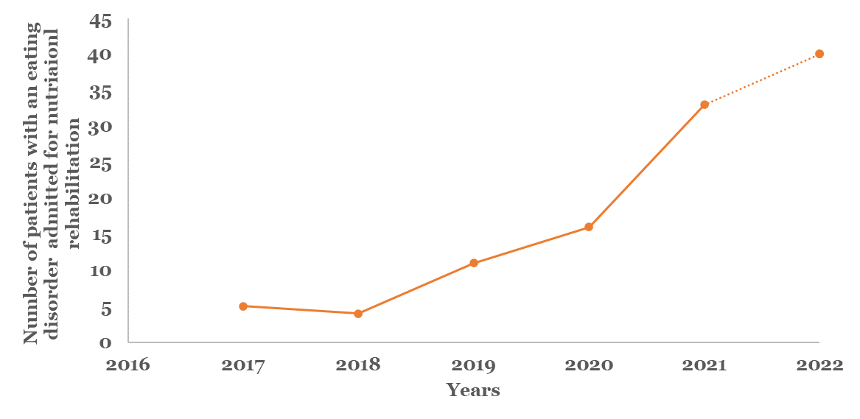
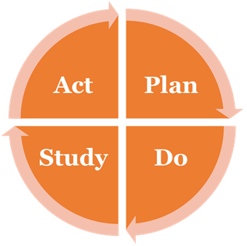
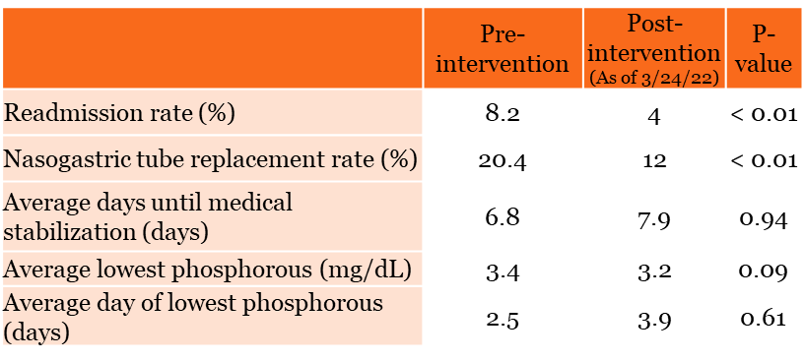
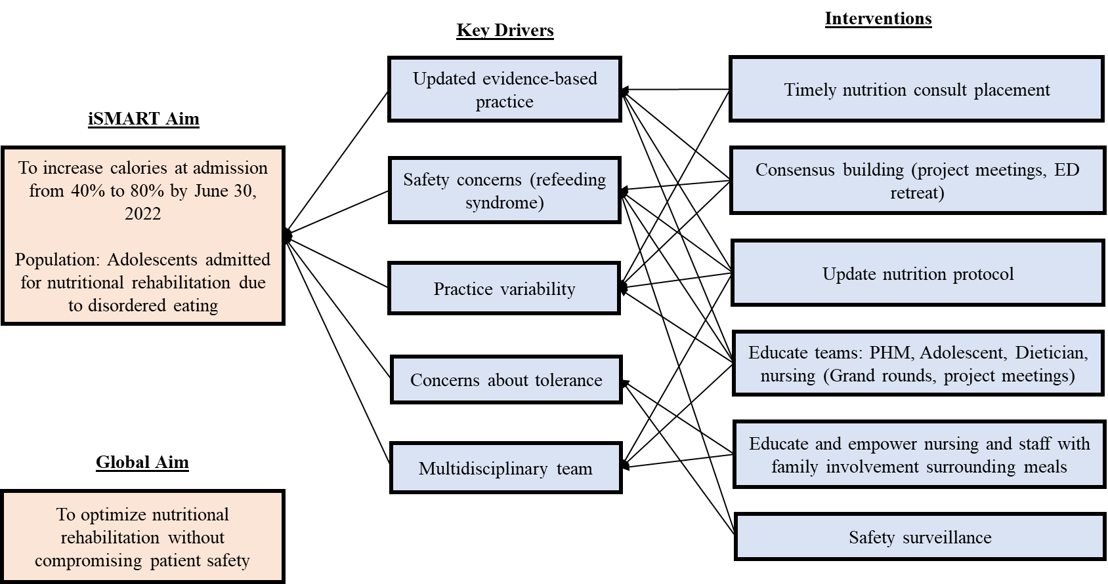
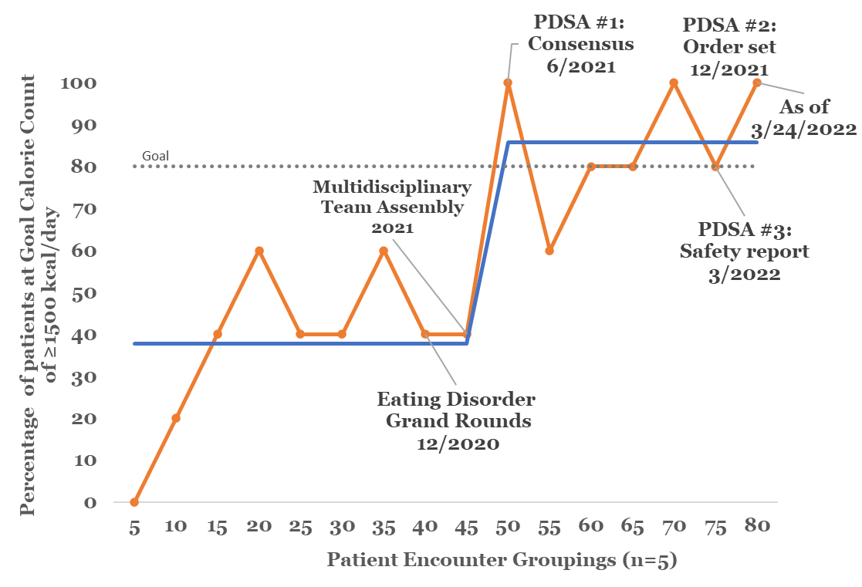
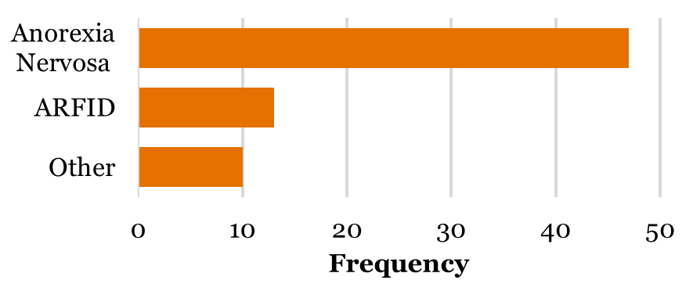
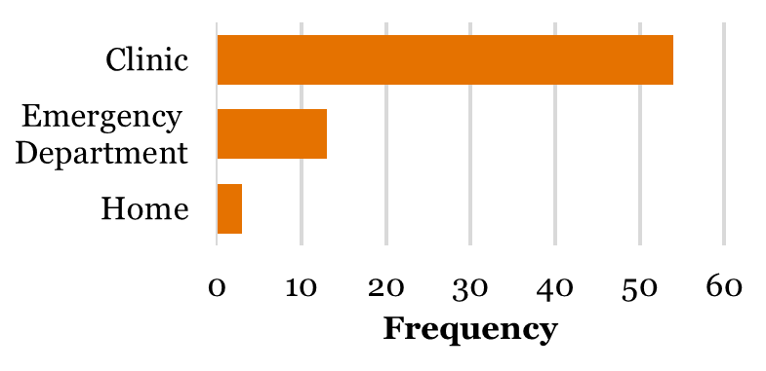
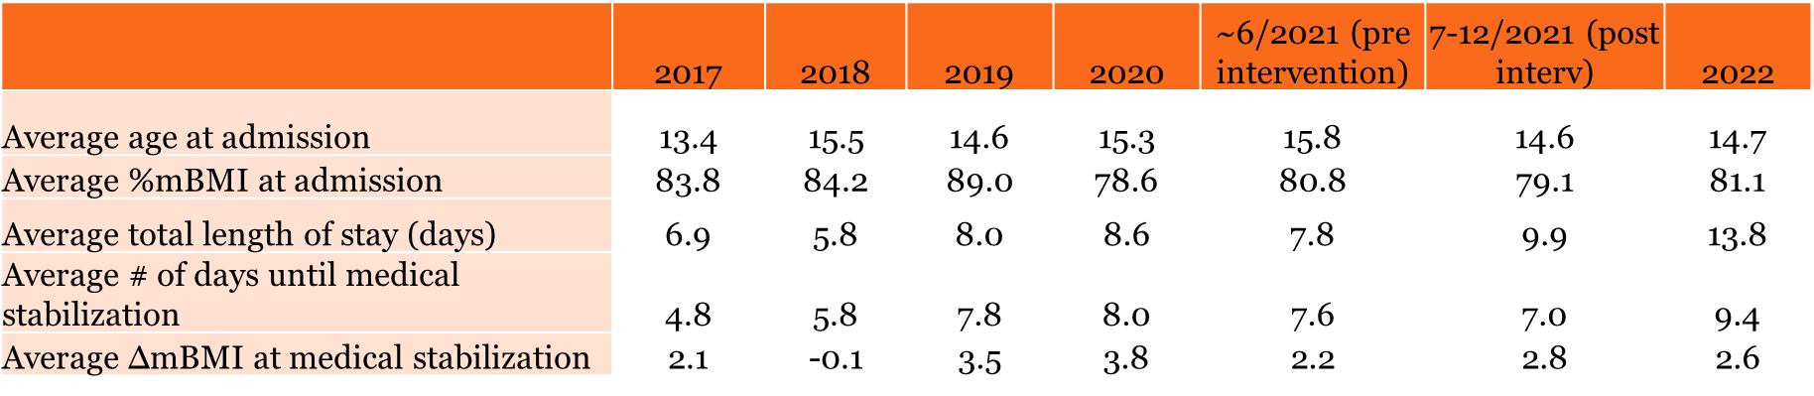
Safe Implementation of Evidence-Based Nutritional Rehabilitation for Hospitalized Adolescents with Eating Disorders
Miyabi Saito, BS¹, Andrew Burns, MD^{1,2}, Kelsey Berry, MD² , Susan Gray, MD^{1,2}, Eva Manthe, RDN, CSP², Julia Taylor, MD^{1,2}, and Joanne Mendoza, MD^{1,2}
1. University of Virginia School of Medicine 2. University of Virginia Children’s Hospital
Introduction
Methods
Conclusions
Adolescent mental health has worsened internationally during the COVID-19 pandemic^{1,2}
Prevalence & severity at presentation of eating disorders (ED) have increased
Figure 1. UVA Children’s Inpatient ED Population.
Baseline period: N=49, Jan 2017 to May 2021
Intervention period: N=31, starting June 2021, ongoing
REDCap chart review tool
Outcome measures
- Length of stay
- Days until medical stabilization
Process measures:
- Initiating calories at ≥1500kcal/day
- Empiric electrolyte supplementation
Balancing measures:
- Nasogastric tube (NGT) use
- Weight gain
- Readmission rates
- Hypophosphatemia
Model for Improvement approach
PDSA cycles including educational & systemic interventions
Our multidisciplinary team has successfully implemented evidence-based practice improvements without compromising patient safety^{3,4}, starting with the highest yield change – calories at initiation
Table 2. Safety of Interventions (Balancing Measures).
Consensus building & clinical decision tools can be used together to implement change
Impact of COVID19: LOS vs days until medical stabilization
Next Steps:
- High value care: Electrolyte supplementation & testing
- Sustainability plan development
Figure 5. PDSA Cycle.
Results
Baseline median: 37.8%
Updated median: 85.7%
Figure 6. Run Chart of Percent of Patients at Goal Calories at Initiation.
Acknowledgements
Figure 2. Key Driver Diagram.
Sincere thanks to the University of Virginia School of Medicine, Children’s Hospital, & Department of Pediatrics for their support on this quality improvement initiative. Thank you to our entire multidisciplinary team of pediatric hospitalists, adolescent medicine doctors, dieticians, residents, nurses, & medical students who make this effort possible.
Patient Population
Table 1. Average Patient Presentation & ED Severity.
References
Figure 2. Diagnosis
ARFID= avoidant restrictive feeding disorder
Figure 3. Location of Admission
Leeb RT, Bitsko RH, Radhakrishnan L, Martinez P, Njai R, Holland KM. Mental Health-Related Emergency Department Visits Among Children Aged <18 Years During the COVID-19 Pandemic - United States, January 1-October 17, 2020. MMWR Morb Mortal Wkly Rep. 2020;69(45):1675-1680. Published 2020 Nov 13. doi:10.15585/mmwr.mm6945a3
Rodgers RF, Lombardo C, Cerolini S, et al. The impact of the COVID-19 pandemic on eating disorder risk and symptoms. Int J Eat Disord. 2020;53(7):1166-1170. doi:10.1002/eat.23318
Golden NH, Cheng J, Kapphahn CJ, et al. Higher-Calorie Refeeding in Anorexia Nervosa: 1-Year Outcomes From a Randomized Controlled Trial. Pediatrics. 2021;147(4):e2020037135. doi:10.1542/peds.2020-037135
Peebles R, Lesser A, Park CC, et al. Outcomes of an inpatient medical nutritional rehabilitation protocol in children and adolescents with eating disorders. J Eat Disord. 2017;5:7. Published 2017 Mar 1. doi:10.1186/s40337-017-0134-6

Slide 3

Please Take a moment to provide feedback to Joanne Mendoza

