Slide 1
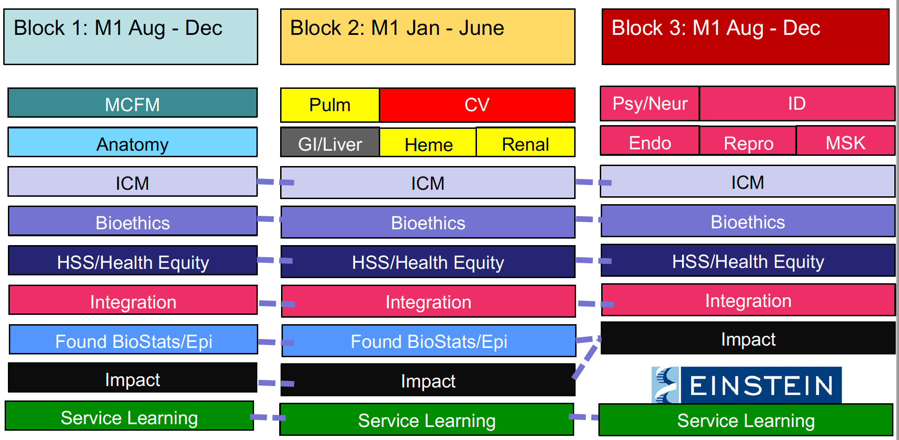
Leading Curricular Change to Promote Integration Hai Jung Helen Rhim, MD, MPH, MHPE
Background
Methods/Changes Implemented
Outcomes/Results Achieved
Many medical schools have embarked on curriculum reform to shorten the preclerkship phase
Historically, preclerkship courses have been discipline-based at Albert Einstein College of Medicine (Einstein)
Einstein has engaged in curricular renewal in the past but the COVID-19 pandemic helped facilitate change
Co-chaired task force to redesign the foundational phase of the curriculum
Co-chaired task force to design a new longitudinal course called Integration
Piloted curricular innovations as components of the new Integration Course
Trained and mentored a new course director for the Integration Course
Incorporated assessments for Self-Directed Learning
Submitted recommendations to the Executive Curriculum Committee on reallocation of course hours and duration of the preclerkship phase
Submitted recommendations and a blueprint for the new longitudinal Integration Course
Successfully implemented a virtual PBL pilot that is now fully incorporated into the Integration Course
Expanded number of cases and delivery modalities of the Virtual PBL program
Handed over leadership of PBL to course director
Goals/Objectives
Next Steps for your project
Redesign the Einstein curriculum to promote integration of basic, clinical and health systems sciences in a developmentally appropriate and student-centered manner
Restructure and compress the preclerkship phase to 18 months to allow for earlier immersion in the clinical phase
Create and implement a new longitudinal Integration Course
Ongoing content development for Integration Course
Identification and training of new course director
Further development of assessment tools for clinical reasoning
Course and program evaluation of efforts to promote integration within the curriculum

Slide 2
Please take a moment to provide feedback to Hai Jung Helen Rhim

